Slide 1
Cloud Computing Unit-IV Cloud Solutions By. Dr. Samta Gajbhiye

Slide 2
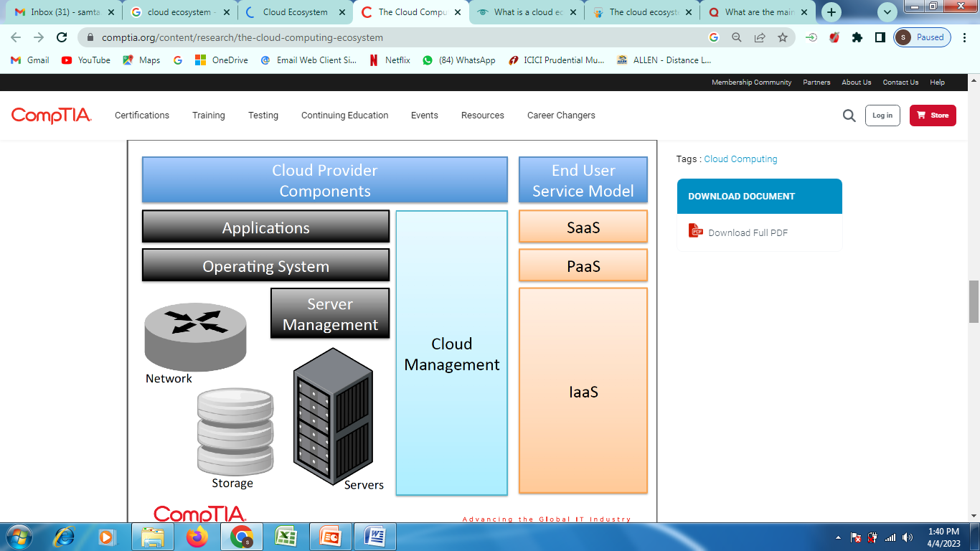
Cloud Ecosystem

Slide 3
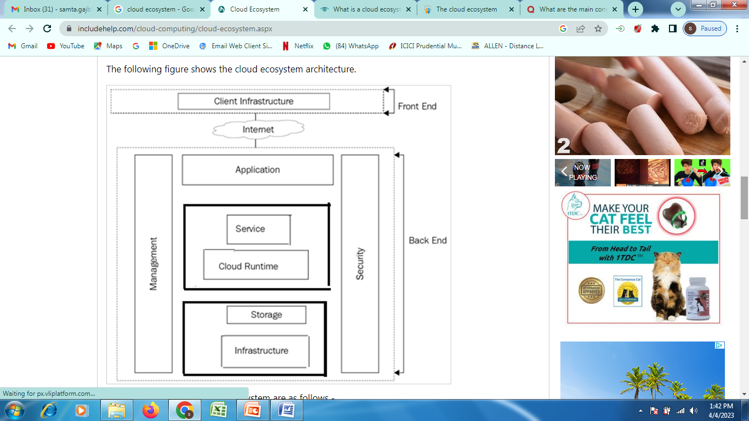
Cloud Ecosystem Cont….

Slide 4
Cloud Ecosystem Cont….
A cloud ecosystem is a dynamic system of interdependent elements, all of which work together to make cloud services possible.
In nature, an ecosystem consists of objects that are linked and work together that are living and non-living.
The ecosystem consists of hardware and software in cloud computing, as well as cloud clients, cloud developers, consultants, integrators, and collaborators.
How a cloud ecosystem works?
A public cloud provider is the nucleus of a cloud environment. It may be an IaaS provider like Amazon Web Services (AWS) or a vendor like Salesforce for SaaS.
Since these businesses overlap, there is no vendor lock-in, making the environment more dynamic.
AWS, for instance, is the core of its ecosystem, but it is also a part of the ecosystem of the Salesforce.
Salesforce runs a variety of its services on the infrastructure of AWS, and Salesforce clients can access parts of AWS, such as its Simple Storage Service, through devices called connectors.

Slide 5
Cloud Ecosystem Cont….
The main actors of the Cloud Ecosystem are as follows -
Cloud Service User
Cloud service user (CSU) is an individual or company who uses cloud services that are distributed.
End-users may be individuals, machines, or apps.
Cloud service Provider
A company that provides and manages the cloud services provided.
Cloud Service Partner
An entity or organization which supports the creation of the service offer by a partner.
A robust ecosystem provides a cloud provider's customers with an easy way to find and purchase business applications and respond to changing business needs. When the apps are sold through a provider’s app store such as AWS Marketplace, Microsoft Azure Marketplace (for cloud software) or Microsoft AppSource (for business applications), the customer essentially has access to a catalog of different vendors' software and services that have already been vetted and reviewed for security, risk and cost.

Slide 6
Cloud Business Process Management
Business Process Management (BPM) is a continuous process in which organizational activities are evaluated and enhanced.
For an instance let’s consider the process of vacation approval in an HR department. A lot of email exchanges will need to occur without BPM implementation in the organization. With BPMS, however, it is possible to automate vacation requests, thereby improving document management, increasing the speed of requests, and improving system performance.
For the modeling, management, and monitoring of business processes, BPMS offers a wide range to fulfill all the necessary needs. The principle of dividing a business process and putting operations and data in both the enterprise and the cloud has been suggested.
The BPMS architecture facilitates organizations to take place their sensitive data and non-computing-intensive operations within the organization itself, while it is possible to place less sensitive data and scalable operations in the cloud.

Slide 7
Cloud Business Process Management
Business process management (BPM), as defined by Gartner employs methods to discover, model, analyze, measure, improve and optimize business strategy and processes.
By incorporating advanced analytics, activity monitoring, and decision management capabilities, business process management suites are able to coordinate people, systems, and information and material to achieve business outcomes. As a result, they have been particularly helpful in accelerating digital transformation strategies.
While business process management applications aren’t new, technological advancement now presents you with the opportunity to move to cloud business process management software.
Business Process as a Service
Any business process, such as payroll, accounting, or e-commerce, offered over the internet as a platform and available by PCs and smart devices, can be regarded as a business process as a service (BPaaS).
In conjunction with low monthly subscription rates and libraries of pre-built software, cloud-delivered BPM with minimal or non-existent start-up costs would make the power of Business Process Management accessible and affordable to any company.

Slide 8
Cloud Business Process Management
Why You Need a Cloud BPM Software?
Minimized Errors: Cloud BPM solutions help you keep error rates minimal. Say goodbye to mountains of paperwork and manual data entry riddled with errors. Multiple records are also eliminated since changes are synced and visible to every team with access.
Anywhere, Anytime Access: Legacy systems store data on a local drive. This can be rather limited in terms of access. Cloud BPM, on the other hand, stores information in a centralized database thereby making access possible any time from any location. Further, stakeholders can access the application from any device.
Secure Data: Data security is an often-expressed concern from organizations when presented with the opportunity to move to cloud BPM. Limiting access to confidential information is high on the list of requirements.
Cloud BPM applications such as Kissflow come with a wide range of security features such as role-based access, conditional visibility, data encryption, and more.
Reputed cloud business process management service providers host their applications on reliable platforms such as Amazon Web Services or Google Cloud Platform, which in turn improves the security of sensitive information.

Slide 9
Cloud Business Process Management
Reliable, Consistent Experience: With legacy systems users are constantly threatened by the possibility of server downtime and virus or malware attacks. With cloud BPM, vendors provide ample backup to ensure that there’s minimal downtime if at all. They also protect data using built-in firewalls.
Minimal Setup and Maintenance
When you use on-premise software, you’re saddled with endless details like installation, configuration, storing data, ensuring adequate space to run the software, buying additional hardware, and arranging for backups. As for updates, installing them on each system and scheduling required downtime becomes your responsibility. Whatever the software needs to function, it becomes your burden to bear. Needless to say, your IT department’s time and energy are heavily taxed.
With cloud BPM, the vendor assumes responsibility for all day-to-day operations of the application. This includes aspects such as performance, memory, storage, hosting, backups, and downtime. In case of new releases or bug fixes, they are immediately implemented for all users. This means that your IT department can focus on other pressing matters. Meanwhile, any issues you encounter are easily addressed by round-the-clock support from your cloud business process management vendor.

Slide 10
Cloud Service Management
Plan, design, and implement cloud operations to monitor and manage your cloud platform and the applications that run in the cloud.
Cloud Service Management and Operations entails all the activities that an organization does to plan, design, deliver, operate, and control the IT and cloud services that it offers to customers.
Service management includes the operational aspects of your applications and services.
After an application is pushed to production, it must be managed.
Applications are monitored to ensure availability and performance according to service level agreements (SLAs) or service level objectives (SLOs).
Cloud Services Management are the processes that enable in managing entire cloud operations and assets on Cloud Service Platform.
Cloud Service Management helps cloud administrators in managing and controlling end-to-end Cloud-hosted and sourced IT assets and services.
Purpose: Establish suitable techniques for managing and running cloud-based services. Insert cloud service management techniques into current frameworks for IT creation and support.
Cloud Service Management (CSM) is the cloud version of Information Technology Service Management (ITSM).
Traditionally, IT departments have had to manage both hardware and software in order to deliver IT services in an efficient and cost-effective manner. The drive towards budget optimization inevitably led to cloud services.

Slide 11
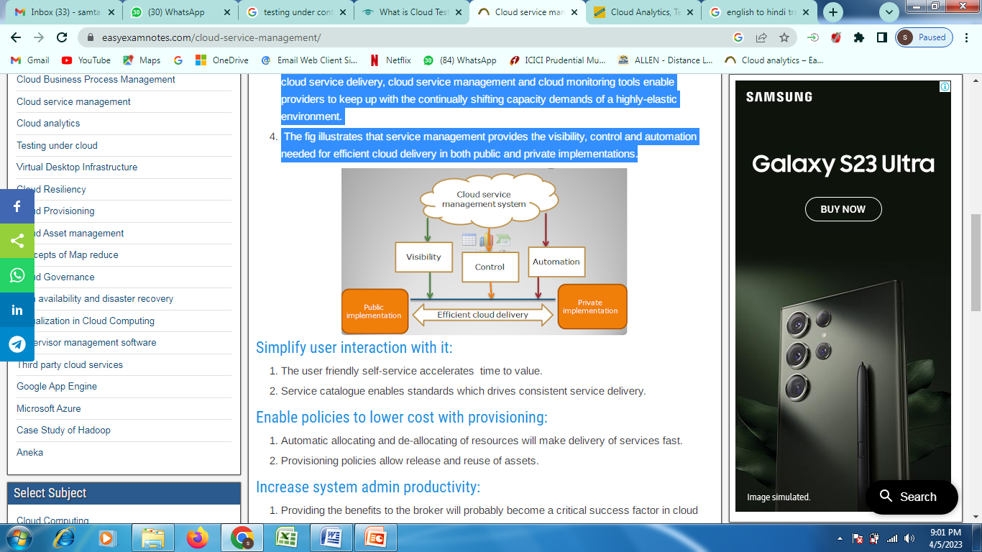
Cloud Service Management Cont….
Cloud monitoring and cloud service management tools allow cloud providers to ensure optimal performance, continuity and efficiency in virtualized, on-demand environments.
In addition to best practices for effective administration of all the elements associated with cloud service delivery, cloud service management and cloud monitoring tools enable providers to keep up with the continually shifting capacity demands of a highly-elastic environment.
The fig illustrates that service management provides the visibility, control and automation needed for efficient cloud delivery in both public and private implementations.

Slide 12
Cloud Service Management Cont….
Simplify user interaction with it:
The user friendly self-service accelerates time to value.
Service catalogue enables standards which drives consistent service delivery.
Enable policies to lower cost with provisioning:
Automatic allocating and de-allocating of resources will make delivery of services fast.
Provisioning policies allow release and reuse of assets.
Increase system admin productivity:
Providing the benefits to the broker will probably become a critical success factor in cloud computing.
Due to the growth of service brokerage business will increase the ability of cloud consumers to use services in a trustworthy manner.
These cloud mediators will help companies to choose the right platform, deploy the apps across multiple clouds.
Following are the opportunities for cloud brokers:
Cloud service intermediation : The broker must need to manage the additional securities or management capabilities over the cloud.
Cloud aggregation: It includes the deployment of services over multiple cloud platforms.
The ability to group an application across multiple clouds will become important i.e. if one service goes down the another can be started.

Slide 13
Cloud Service Management Cont….
How Cloud Service Management is used?
Cloud Service Management primarily provides means to manage and control Cloud Service operations and performance at a granular level.
It is delivered through a combination of Cloud Service Management tools, technologies, and processes.
Cloud Service Management generally provides:
Management and control over all cloud services and assets.
Control access to applications and services and implement mechanism to track all event logs
Define, implement and monitor Key Performance Indicators (KPIs)
Windows Application and System Event logs
Ensure redundancy, backup, and recovery for cloud resources and services

Slide 14
Cloud Service Management Cont….
How Cloud Service Management helps?
It provides rich cloud monitoring features like live dashboards, fully customizable and meaningful alerts, immediate notifications, and much more.
Cloud Service Management Software helps Cloud Administrators in;
Auto-Scalability – Scale in real-time and add extra servers automatically as demand increases and drop them when it decreases.
Crash Recovery – Auto restart of crashed processes.
End-to-end Management – management features span across all Cloud Service resources and applications.

Slide 15
Cloud Analytics
Cloud analytics is the process of storing and analyzing data in the cloud and using it to extract actionable business insight.
Cloud analytics algorithms are applied to large data collections to identify patterns, predict future outcomes and produce other information useful to business decision makers.
Cloud analytics is generally a more efficient alternative to on-premises analytics .
While on-premises analytics solutions give companies internal control over data privacy and security, they are difficult and expensive to scale. Cloud analytics, on the other hand, benefits from the scalability, service models and cost savings of cloud computing.
Businesses generate terabytes of data in the course of daily operations. Today, most of this data — sourced from websites, social media, IT devices and financial software, among other things — exists in the cloud.
Cloud analytics tools and analytics software are particularly efficient for processing these huge data sets, producing insights in easily digestible formats and creating insights from data in the cloud available on demand, resulting in a better and more streamlined user experience.

Slide 16
Cloud Analytics Cont….
How does cloud analytics work?
As the name suggests, cloud analytics systems must be hosted on an internet platform.
In most cases, they are run on state-of-the-art data centers that can provide the processing power and storage space needed for analyzing massive amounts of data.
In cloud analytics systems, all generated data is collected and securely stored in the cloud, where it can be accessed from any internet-connected device.
The cloud analytics system can then clean, organize, process, and analyze the data using proprietary algorithms.
These insights are presented to the user through different data visualizations and other intuitive formats.

Slide 17
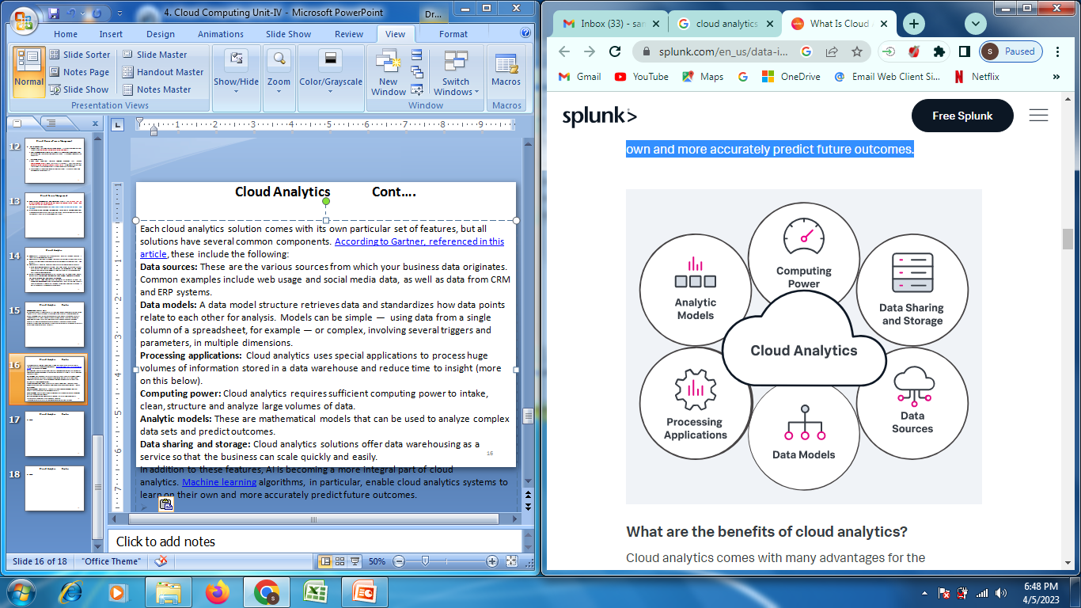
Cloud Analytics Cont….
Cloud analytics solution common components.

Slide 18
Cloud Analytics Cont….
Each cloud analytics solution comes with its own particular set of features, but all solutions have several common components. According to Gartner,, these include the following:
Data sources: These are the various sources from which your business data originates. Common examples include web usage and social media data, as well as data from CRM and ERP systems.
Data models: A data model structure retrieves data and standardizes how data points relate to each other for analysis.
Processing applications: Cloud analytics uses special applications to process huge volumes of information stored in a data warehouse and reduce time to insight (more on this below).
Computing power: Cloud analytics requires sufficient computing power to intake, clean, structure and analyze large volumes of data.
Analytic models: These are mathematical models that can be used to analyze complex data sets and predict outcomes.
Data sharing and storage: Cloud analytics solutions offer data warehousing as a service so that the business can scale quickly and easily.
In addition to these features, AI is becoming a more integral part of cloud analytics. Machine learning algorithms, in particular, enable cloud analytics systems to learn on their own and more accurately predict future outcomes.

Slide 19
Cloud Analytics Cont….
What are the benefits of cloud analytics? Few benefits with the biggest impact on your business.
Data consolidation: Big data produced from numerous, disparate sources across the organization makes it nearly impossible to get a unified view. Cloud analytics brings all of a company’s data sources together to produce a more complete picture. All stakeholders, regardless of their physical location (or the data’s location), can easily access this data in one place, to gain more accurate insights and make better business decisions in real time.
Sharing and collaboration: Big data siloed in individual departments such as Finance or Human Resources affect the whole business. A cloud analytics solution can better integrate the data from different parts of the organization — subject to configurable role-based access controls — leading to better communication and decision making.

Slide 20
Cloud Analytics Cont….
Scalability: When workloads and data volumes grow rapidly, administrators running on-premise platforms have to purchase and install new hardware to accommodate the rise in demand —a service model that often leads to over provisioning and expenses that can seem unnecessary if demand falls in the future. With cloud analytics services, organizations can scale up to accommodate spikes in demand by bringing more instances online (or reducing them when demand dips) and paying only for what they use.
Cost reduction: In addition to the costs of the various hardware requirements, on-premise platforms need frequent upgrades and migrations, invariably leading to system downtime affecting business continuity. On-premise analytics also necessitate specialized skill sets that some organizations don’t or can’t afford to have in-house. With cloud analytics, organizations aren’t required to purchase and support additional hardware, and can also avail the in-house expertise of service providers.

Slide 21
Cloud Analytics Cont….
Security: Security monitoring is usually just one of the many areas that an organization’s IT staff is responsible for, but it’s a full-time focus for cloud hosts. Cloud analytics providers also use robust encryption to secure data as it is transmitted over networks. But the biggest security advantage they offer may be simply that the data is stored offsite: A recent report found that 34 percent of all breaches happened as a result of insider threat actors, including current and former employees who take classified or proprietary information with them when they leave the company.

Slide 22
Cloud Analytics Cont….
What is a data warehouse?:
A data warehouse is an electronic system for storing aggregated data from many different sources within an enterprise for analysis and reporting.
Data warehousing is usually offered as part of a cloud analytics platform.
To create a data warehouse, data is compiled from an organization’s various sources and “cleaned” — a process through which corrupt, inaccurate, incomplete, improperly formatted, and duplicate records are corrected or removed.
After the data is cleaned, it’s converted from a database format, which is designed for transaction processing, to a data warehouse format, which is designed for query and analysis.
Once in the warehouse, the data is sorted, consolidated, correlated, and otherwise processed so it can be compared and analyzed.
Data is continually added as the various data sources are updated so the data store remains current.

Slide 23
Cloud Analytics Cont….
What is business intelligence (BI)?:
Business intelligence — or cloud BI — is a solution that cloud analytics providers commonly offer through a software as a service (SaaS) model.
In this context, BI refers to the tools and technologies that are used for the collection and parsing of business data.
BI encompasses a number of processes including online analytical reporting (OLAP), data and text mining, predictive and descriptive analytics, and performance benchmarking.
BI software gathers and analyzes relevant data from a data warehouse and produces easy-to-understand reports and data visualizations.
BI works together with data analytics to help businesses optimize performance and make better business decisions.

Slide 24
Cloud Analytics Cont….
BI and cloud BI can be used to inform virtually any business decision. Some of the most common uses include:
Analyzing customer behavior. BI can help organizations determine why a particular customer strategy did or didn’t work, identify behavior patterns, and more.
Developing revenue strategies. BI can help organizations develop revenue growth strategies by identifying ideal customers, providing insight into purchasing decisions, and helping determine what will drive conversions.
Uncovering business problems. BI software often integrates with financial software, allowing businesses to view data from a variety of angles and detect problems that might otherwise be missed.
Optimizing performance. BI allows organizations to track goals such as sales targets and project deadlines, identify reachable goals, keep teams on course, and alert managers when goals are near completion.

Slide 25
Cloud Analytics Cont….
How do you choose the best cloud analytics platform?: Not all cloud analytics platforms are created equally, so it will pay off in the long run if you take time to identify your organization’s particular needs before making a purchasing decision. Some key factors to consider include:
Scalability. A good cloud analytics platform will be able to accommodate your growing business and its data needs. Flexible pricing plans will allow you to pay for only the resources you use.
Security. While nearly all cloud providers encrypt data as it’s moving over a network, many do not secure data when it is just sitting in storage. Look for a platform that encrypts data both “in transit” and “at rest.”
Real-time integration. Your cloud analytics platform should integrate in real time with your organization’s other systems so your company can stay up to date without any extra efforts.
Analytics features. Every company is guided by unique business metrics. Look for a cloud analytics platform that is capable of calculating yours.
Responsive interface. Data analysis is increasingly run on mobile devices. Make sure any cloud analytics platform you’re considering isn’t going to bog down on users’ smartphones and tablets.

Slide 26
Cloud Analytics Cont….
What are some challenges when leveraging multiple cloud analytics platforms?
Trends around multi-cloud (the use of multiple cloud providers), and hybrid cloud (the combination of private and public cloud infrastructures) are both growing.
Businesses opt for hybrid cloud as a means of balancing workloads — using the public cloud for computing or storage spikes, for example. They choose multi-cloud when different providers meet different business needs.
One of the most significant challenges for both environments (multi cloud and hybrid cloud ) is security. A private cloud consolidates data security within the organization, but that changes as soon as you move some or all of that data to a public cloud and the organization has to manage two security platforms. Security issues are more obvious in a multi-cloud environment because the organization has multiple security platforms to manage without any control of their security processes or policies.
Data governance and compliance also become more challenging in these cloud environments. It becomes more difficult to know where data is located, particularly in a multi-cloud environment, and can easily lead to regulatory compliance violations that put your business at risk. It’s critical that IT has the proper tools available to monitor these environments and meet the organization’s specific regulatory requirements.

Slide 27
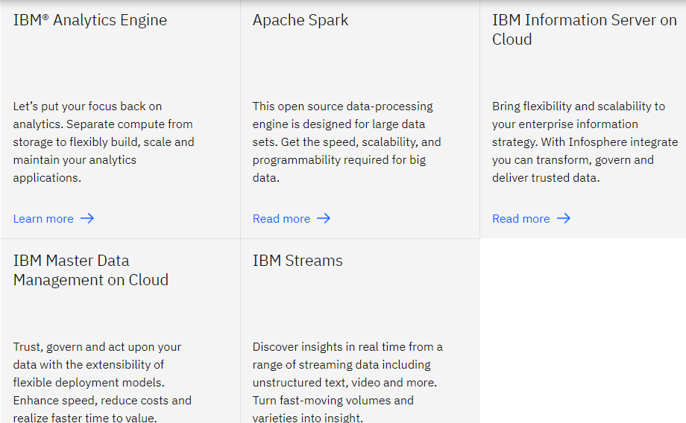
Cloud Analytics Cont….

Slide 28
Testing Under Cloud
Cloud testing typically involves monitoring and reporting on real-world user traffic conditions as well as load balance and stress testing for a range of simulated usage conditions.
Load and performance testing conducted on the applications and services provided via cloud computing particularly the capability to access these services in order to ensure optimal performance and scalability under a wide variety of conditions.
Consumers can access the IT resources in the test environment.
Testing under the cloud gives very good sign by decreasing the manual intervention and reducing the processes in the typical testing environment.

Slide 29
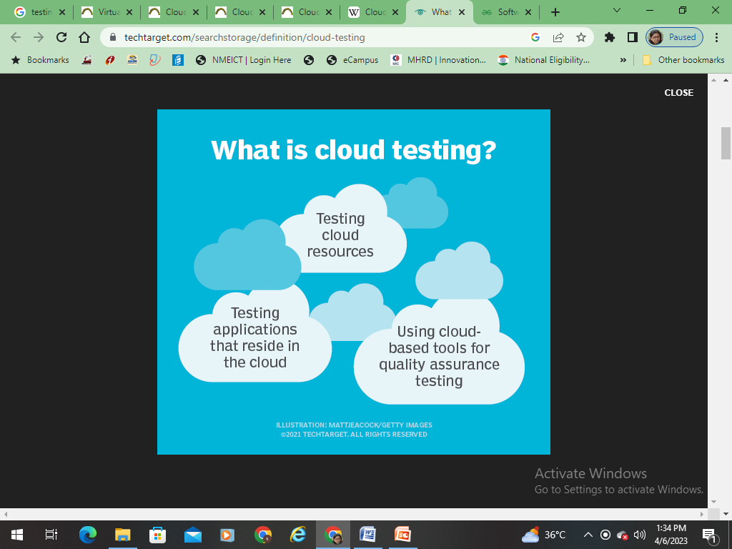
Cloud Testing Under Control Cont….
Cloud Testing is one type of software testing in which the software applications are tested by using cloud computing services.
Cloud testing intends to test the software based on functional and non-functional requirements using cloud computing services that ensure faster availability, scalability, and flexibility that saves time and cost for software testing
This can refer to the testing of cloud resources, such as architecture or cloud-native software as a service (SaaS) offerings, or using cloud tools as a part of quality assurance (QA) strategy.

Slide 30
Cloud Testing Under Control Cont….
Forms of Cloud Testing
There are four forms of Cloud Testing performed:
Testing of the whole cloud: In this, the cloud is taken as a whole entity, and based on its features, testing is carried out.
Testing within a cloud: This is the testing that is carried out internally inside the cloud by testing each of its internal features.
Testing across the clouds: In this, the testing is carried out based on the specifications on the different types of clouds-like public, private and hybrid clouds.
SaaS testing in the cloud: In this, functional and non-functional testing takes place based on requirements.

Slide 31
Cloud Testing Under Control Cont….
Testing Performed within the Cloud
Testing in a cloud should not solely make sure that the functional necessities are met, but a robust emphasis needs to be set on non-functional testing also. Let’s explore the various types of testing that are performed.
Functional Testing: Functional Testing should be performed to make sure that the offering provides the services that the user is paying for. Functional tests ensure that the business needs are being met.
System Verification Testing: This testing ensures that the various modules work properly with one another.
Interoperability Testing: Any application must have the flexibility to work without any problems not only on different platforms, and it should conjointly work seamlessly when moving from one cloud infrastructure to a different one.
Acceptance Testing: Here the cloud-based resolution is handed over to the users to make sure it meets their expectations.

Slide 32
Cloud Testing Under Control Cont….
2. Non-Functional Testing: Non-functional tests primarily specialize in web application-based tests ensuring that they meet the required needs. Here are a few types of non-functional tests mentioned below-
Performance Testing: In this testing, the response time to any user request must be verified to ensure that everything is intact even when there are loads of requests to be satisfied. Network latency is additionally one of the crucial factors to evaluate performance. Also, workload balancing must be done once there’s a reduction in load, by decommissioning resources.
Stress testing: This testing helps to determine the ability of cloud applications to function under peak workloads while staying effective and stable.
Load testing: This testing helps to measure the cloud application’s response concerning user traffic loads.
Latency testing: In this testing the latency time between action and responses within an application with respect to a user request.

Slide 33
Cloud Testing Under Control Cont….
Availability Testing: This testing determines the cloud must available all the time round the clock. As there might be any mission-critical activities that can happen, the administrator i.e., cloud vendor should ensure that there’s no adverse impact on the customers.
Multi-Tenancy Testing: In this cloud testing, multiple users use a cloud offering as a demo. Testing is performed to confirm that there’s adequate security and access control of the data when multiple users are working in a single instance.
Scalability Testing: This testing is performed to make sure that the offerings provided can scale up or scale down as per the customer’s need.
Browser Performance testing: In this testing performance of a cloud-based application i.e., the applications deployed over the cloud is tested across different web browsers.
Security Testing: As Cloud provides everything at any time, it is very important that all user-sensitive data must be secured and has no unauthorized access to maintain users’ privacy.
Disaster Recovery Testing: In availability testing, the cloud has to be available at all times, if there are any types of failures occur like network outages, breakdown due to high load, system failure, etc. this testing ensures how fast the failure can be captured and if any data loss occurs during this period.
Notes:
Tools for Functional Testing in Cloud
There are many tools used for testing performance, load, stress testing in or of cloud. Some of these testing tools are mentioned below:
AppPerfect: AppPerfect is a software development company located in Sunnyvale, CA. It markets supports and develops a set of testing and monitoring products that are used to analyze, test, and monitor web and windows-based applications.
Jmeter: Apache JMeter is an open-source, Java-based application software designed to load testing tools to analyze and monitor the performance of the services and web applications.
SOASTA CloudTest: SOASTA cloud test is a cross-platform test management tool with a user-friendly design.
LoadStorm: It is a tool to manage and monitor the performance of the entire cloud infrastructure and produces a real-time graph for performance analysis.
Tools for Security Testing in Cloud
The following are the tools for security testing in the cloud:
Nessus: Nessus is a remote security scanning tool that scans the system and raises an alert if any vulnerability is discovered that hackers could use to get unauthorized access to sensitive data.
Wireshark: Wireshark is an open-source packet analyzer used for network troubleshooting and monitoring, software, and communications protocols development.
Nmap: Nmap is a network scanner that is used to discover hosts and services on a network by sending packets and analyzing the response.
Benefits Of Cloud Testing
The following are some of the benefits of cloud testing:
Availability of Required testing environment: In cloud testing, testing teams can easily replicate the customer’s environment for effective testing of the cloud without investing in the additional hardware and software resources for testing. These resources can be accessed from any device with a network connection.
Less expensive: Cloud testing is more cost-efficient than traditional methods of testing, as there is no need of investing in additional hardware and software resources. Customers, as well as the testing team, only pay for what they use.
Faster testing: Cloud testing is faster than the traditional method of testing as most of the management tasks like physical infrastructure management for testing are removed.
Scalability: The cloud computing resources can be increased and decreased whenever required, based on testing demands.
Customization: Cloud testing can be customized as per the usage, cost and time based on the variety of users and user’s environment.
Disaster recovery: Disaster recovery is easily possible as the data backup is taken at the cloud vendors as well as at the user’s end also.

Slide 34
Cloud Testing Under Control Cont….
Types of Cloud Testing
There are three types of cloud testing:
Cloud-Based Application Tests over Cloud: These types of tests help determine the quality of cloud-based applications concerning different types of clouds.
Online-Based Application Tests on a Cloud: Online application supervisors/vendors perform these tests to check the functions and performance of their cloud-based services. This testing takes place with the help of Functional Testing. Online applications are connected with a legacy system and the connection quality between the application and the legacy system is tested. [Application vendor supporting cross-function business process. This type of application vendor has a significant business footprint in an enterprise, offers capability to import other application data, has an application development platform, and likely has cloud-based support]
SaaS or Cloud Oriented Testing: These tests are performed by SaaS or Cloud vendors. The objective of these tests is to evaluate the quality of individual service functions that are offered in SaaS or cloud programs.

Slide 35
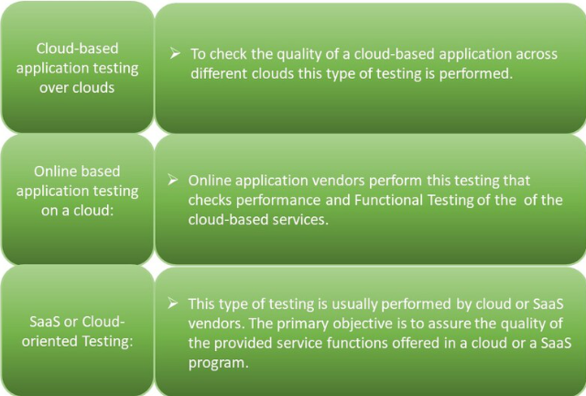
Cloud Testing Under Control Cont….

Slide 36
Cloud Testing Under Control Cont….
Tools for Functional Testing in Cloud
There are many tools used for testing performance, load, stress testing in or of cloud.
AppPerfect: AppPerfect is a software development company located in Sunnyvale, CA. It markets supports and develops a set of testing and monitoring products that are used to analyze, test, and monitor web and windows-based applications.
Jmeter: Apache JMeter is an open-source, Java-based application software designed to load testing tools to analyze and monitor the performance of the services and web applications.
SOASTA CloudTest: SOASTA cloud test is a cross-platform test management tool with a user-friendly design.
LoadStorm: It is a tool to manage and monitor the performance of the entire cloud infrastructure and produces a real-time graph for performance analysis.
Notes:
Tools for Functional Testing in Cloud
There are many tools used for testing performance, load, stress testing in or of cloud. Some of these testing tools are mentioned below:
AppPerfect: AppPerfect is a software development company located in Sunnyvale, CA. It markets supports and develops a set of testing and monitoring products that are used to analyze, test, and monitor web and windows-based applications.
Jmeter: Apache JMeter is an open-source, Java-based application software designed to load testing tools to analyze and monitor the performance of the services and web applications.
SOASTA CloudTest: SOASTA cloud test is a cross-platform test management tool with a user-friendly design.
LoadStorm: It is a tool to manage and monitor the performance of the entire cloud infrastructure and produces a real-time graph for performance analysis.
Tools for Security Testing in Cloud
The following are the tools for security testing in the cloud:
Nessus: Nessus is a remote security scanning tool that scans the system and raises an alert if any vulnerability is discovered that hackers could use to get unauthorized access to sensitive data.
Wireshark: Wireshark is an open-source packet analyzer used for network troubleshooting and monitoring, software, and communications protocols development.
Nmap: Nmap is a network scanner that is used to discover hosts and services on a network by sending packets and analyzing the response.
Benefits Of Cloud Testing
The following are some of the benefits of cloud testing:
Availability of Required testing environment: In cloud testing, testing teams can easily replicate the customer’s environment for effective testing of the cloud without investing in the additional hardware and software resources for testing. These resources can be accessed from any device with a network connection.
Less expensive: Cloud testing is more cost-efficient than traditional methods of testing, as there is no need of investing in additional hardware and software resources. Customers, as well as the testing team, only pay for what they use.
Faster testing: Cloud testing is faster than the traditional method of testing as most of the management tasks like physical infrastructure management for testing are removed.
Scalability: The cloud computing resources can be increased and decreased whenever required, based on testing demands.
Customization: Cloud testing can be customized as per the usage, cost and time based on the variety of users and user’s environment.
Disaster recovery: Disaster recovery is easily possible as the data backup is taken at the cloud vendors as well as at the user’s end also.

Slide 37
Cloud Testing Under Control Cont….
Tools for Security Testing in Cloud
The following are the tools for security testing in the cloud:
Nessus: Nessus is a remote security scanning tool that scans the system and raises an alert if any vulnerability is discovered that hackers could use to get unauthorized access to sensitive data.
Wireshark: Wireshark is an open-source packet analyzer used for network troubleshooting and monitoring, software, and communications protocols development.
Nmap: Nmap is a network scanner that is used to discover hosts and services on a network by sending packets and analyzing the response.
Notes:
Tools for Functional Testing in Cloud
There are many tools used for testing performance, load, stress testing in or of cloud. Some of these testing tools are mentioned below:
AppPerfect: AppPerfect is a software development company located in Sunnyvale, CA. It markets supports and develops a set of testing and monitoring products that are used to analyze, test, and monitor web and windows-based applications.
Jmeter: Apache JMeter is an open-source, Java-based application software designed to load testing tools to analyze and monitor the performance of the services and web applications.
SOASTA CloudTest: SOASTA cloud test is a cross-platform test management tool with a user-friendly design.
LoadStorm: It is a tool to manage and monitor the performance of the entire cloud infrastructure and produces a real-time graph for performance analysis.
Tools for Security Testing in Cloud
The following are the tools for security testing in the cloud:
Nessus: Nessus is a remote security scanning tool that scans the system and raises an alert if any vulnerability is discovered that hackers could use to get unauthorized access to sensitive data.
Wireshark: Wireshark is an open-source packet analyzer used for network troubleshooting and monitoring, software, and communications protocols development.
Nmap: Nmap is a network scanner that is used to discover hosts and services on a network by sending packets and analyzing the response.
Benefits Of Cloud Testing
The following are some of the benefits of cloud testing:
Availability of Required testing environment: In cloud testing, testing teams can easily replicate the customer’s environment for effective testing of the cloud without investing in the additional hardware and software resources for testing. These resources can be accessed from any device with a network connection.
Less expensive: Cloud testing is more cost-efficient than traditional methods of testing, as there is no need of investing in additional hardware and software resources. Customers, as well as the testing team, only pay for what they use.
Faster testing: Cloud testing is faster than the traditional method of testing as most of the management tasks like physical infrastructure management for testing are removed.
Scalability: The cloud computing resources can be increased and decreased whenever required, based on testing demands.
Customization: Cloud testing can be customized as per the usage, cost and time based on the variety of users and user’s environment.
Disaster recovery: Disaster recovery is easily possible as the data backup is taken at the cloud vendors as well as at the user’s end also.

Slide 38
Cloud Testing Under Control Cont….
Benefits Of Cloud Testing
The following are some of the benefits of cloud testing:
Availability of Required testing environment: In cloud testing, testing teams can easily replicate the customer’s environment for effective testing of the cloud without investing in the additional hardware and software resources for testing. These resources can be accessed from any device with a network connection.
Less expensive: Cloud testing is more cost-efficient than traditional methods of testing, as there is no need of investing in additional hardware and software resources. Customers, as well as the testing team, only pay for what they use.
Faster testing: Cloud testing is faster than the traditional method of testing as most of the management tasks like physical infrastructure management for testing are removed.
Scalability: The cloud computing resources can be increased and decreased whenever required, based on testing demands.
Customization: Cloud testing can be customized as per the usage, cost and time based on the variety of users and user’s environment.
Disaster recovery: Disaster recovery is easily possible as the data backup is taken at the cloud vendors as well as at the user’s end also.
Notes:
Tools for Functional Testing in Cloud
There are many tools used for testing performance, load, stress testing in or of cloud. Some of these testing tools are mentioned below:
AppPerfect: AppPerfect is a software development company located in Sunnyvale, CA. It markets supports and develops a set of testing and monitoring products that are used to analyze, test, and monitor web and windows-based applications.
Jmeter: Apache JMeter is an open-source, Java-based application software designed to load testing tools to analyze and monitor the performance of the services and web applications.
SOASTA CloudTest: SOASTA cloud test is a cross-platform test management tool with a user-friendly design.
LoadStorm: It is a tool to manage and monitor the performance of the entire cloud infrastructure and produces a real-time graph for performance analysis.
Tools for Security Testing in Cloud
The following are the tools for security testing in the cloud:
Nessus: Nessus is a remote security scanning tool that scans the system and raises an alert if any vulnerability is discovered that hackers could use to get unauthorized access to sensitive data.
Wireshark: Wireshark is an open-source packet analyzer used for network troubleshooting and monitoring, software, and communications protocols development.
Nmap: Nmap is a network scanner that is used to discover hosts and services on a network by sending packets and analyzing the response.
Benefits Of Cloud Testing
The following are some of the benefits of cloud testing:
Availability of Required testing environment: In cloud testing, testing teams can easily replicate the customer’s environment for effective testing of the cloud without investing in the additional hardware and software resources for testing. These resources can be accessed from any device with a network connection.
Less expensive: Cloud testing is more cost-efficient than traditional methods of testing, as there is no need of investing in additional hardware and software resources. Customers, as well as the testing team, only pay for what they use.
Faster testing: Cloud testing is faster than the traditional method of testing as most of the management tasks like physical infrastructure management for testing are removed.
Scalability: The cloud computing resources can be increased and decreased whenever required, based on testing demands.
Customization: Cloud testing can be customized as per the usage, cost and time based on the variety of users and user’s environment.
Disaster recovery: Disaster recovery is easily possible as the data backup is taken at the cloud vendors as well as at the user’s end also.

Slide 39
Cloud Testing Under Control Cont….
Cloud testing vs. on-premises testing for applications
Compared to a traditional on-premises testing environment, cloud testing offers users pay-per-use pricing, flexibility and reduced time to market. The test processes and technologies used to perform functional testing against cloud-based applications are not significantly different than traditional in-house applications, but awareness of the nonfunctional risks around the cloud is critical to success.
For example, if testing involves production data, then appropriate security and data integrity processes and procedures need to be in place and validated before functional testing can begin. Furthermore, cloud testing can be undertaken from any location or device with a network connection, as opposed to testing on premises, which must take place on site.
Notes:
Tools for Functional Testing in Cloud
There are many tools used for testing performance, load, stress testing in or of cloud. Some of these testing tools are mentioned below:
AppPerfect: AppPerfect is a software development company located in Sunnyvale, CA. It markets supports and develops a set of testing and monitoring products that are used to analyze, test, and monitor web and windows-based applications.
Jmeter: Apache JMeter is an open-source, Java-based application software designed to load testing tools to analyze and monitor the performance of the services and web applications.
SOASTA CloudTest: SOASTA cloud test is a cross-platform test management tool with a user-friendly design.
LoadStorm: It is a tool to manage and monitor the performance of the entire cloud infrastructure and produces a real-time graph for performance analysis.
Tools for Security Testing in Cloud
The following are the tools for security testing in the cloud:
Nessus: Nessus is a remote security scanning tool that scans the system and raises an alert if any vulnerability is discovered that hackers could use to get unauthorized access to sensitive data.
Wireshark: Wireshark is an open-source packet analyzer used for network troubleshooting and monitoring, software, and communications protocols development.
Nmap: Nmap is a network scanner that is used to discover hosts and services on a network by sending packets and analyzing the response.
Benefits Of Cloud Testing
The following are some of the benefits of cloud testing:
Availability of Required testing environment: In cloud testing, testing teams can easily replicate the customer’s environment for effective testing of the cloud without investing in the additional hardware and software resources for testing. These resources can be accessed from any device with a network connection.
Less expensive: Cloud testing is more cost-efficient than traditional methods of testing, as there is no need of investing in additional hardware and software resources. Customers, as well as the testing team, only pay for what they use.
Faster testing: Cloud testing is faster than the traditional method of testing as most of the management tasks like physical infrastructure management for testing are removed.
Scalability: The cloud computing resources can be increased and decreased whenever required, based on testing demands.
Customization: Cloud testing can be customized as per the usage, cost and time based on the variety of users and user’s environment.
Disaster recovery: Disaster recovery is easily possible as the data backup is taken at the cloud vendors as well as at the user’s end also.

Slide 40
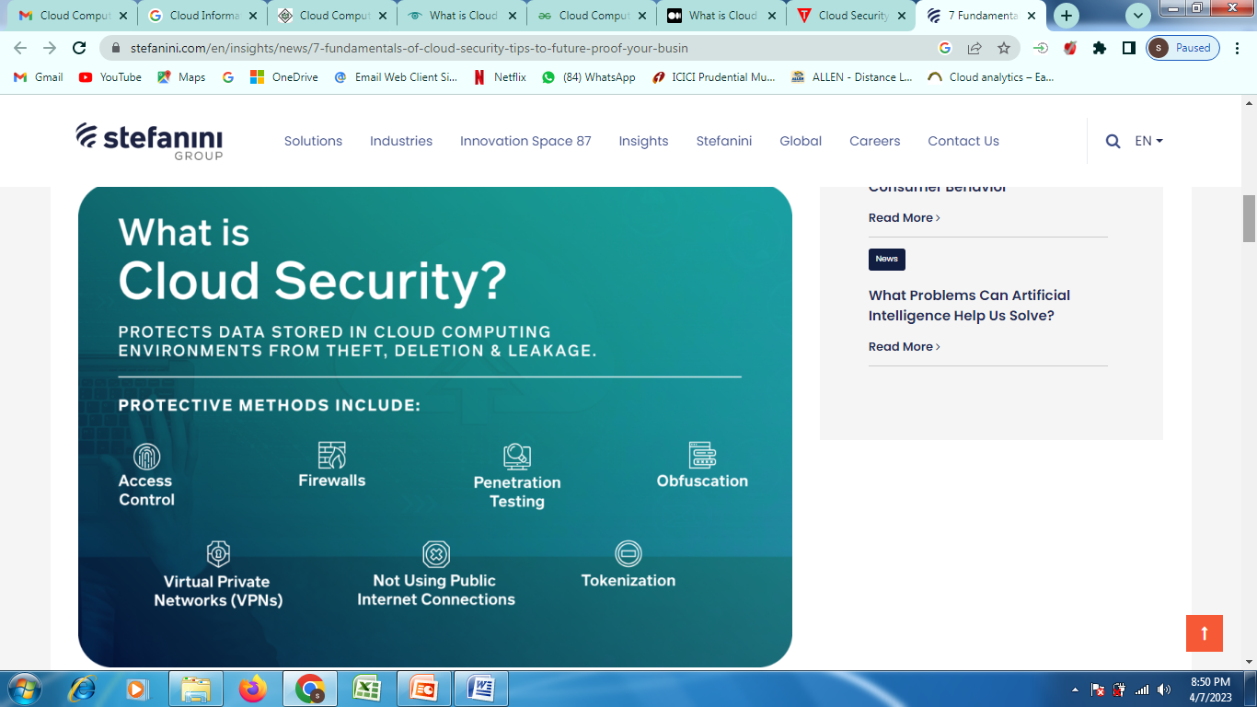
Cloud Security
Cloud security is the set of control-based security measures and technology protection, designed to protect online stored resources from leakage, theft, and data loss. Protection includes data from cloud infrastructure, applications, and threats.
Security applications uses a software the same as SaaS
There are many protective methods that help secure the cloud; these measures include access control, firewalls, penetration testing, obfuscation, tokenization, virtual private networks (VPN), and not using public internet connections.
Notes:
Tools for Functional Testing in Cloud
There are many tools used for testing performance, load, stress testing in or of cloud. Some of these testing tools are mentioned below:
AppPerfect: AppPerfect is a software development company located in Sunnyvale, CA. It markets supports and develops a set of testing and monitoring products that are used to analyze, test, and monitor web and windows-based applications.
Jmeter: Apache JMeter is an open-source, Java-based application software designed to load testing tools to analyze and monitor the performance of the services and web applications.
SOASTA CloudTest: SOASTA cloud test is a cross-platform test management tool with a user-friendly design.
LoadStorm: It is a tool to manage and monitor the performance of the entire cloud infrastructure and produces a real-time graph for performance analysis.
Tools for Security Testing in Cloud
The following are the tools for security testing in the cloud:
Nessus: Nessus is a remote security scanning tool that scans the system and raises an alert if any vulnerability is discovered that hackers could use to get unauthorized access to sensitive data.
Wireshark: Wireshark is an open-source packet analyzer used for network troubleshooting and monitoring, software, and communications protocols development.
Nmap: Nmap is a network scanner that is used to discover hosts and services on a network by sending packets and analyzing the response.
Benefits Of Cloud Testing
The following are some of the benefits of cloud testing:
Availability of Required testing environment: In cloud testing, testing teams can easily replicate the customer’s environment for effective testing of the cloud without investing in the additional hardware and software resources for testing. These resources can be accessed from any device with a network connection.
Less expensive: Cloud testing is more cost-efficient than traditional methods of testing, as there is no need of investing in additional hardware and software resources. Customers, as well as the testing team, only pay for what they use.
Faster testing: Cloud testing is faster than the traditional method of testing as most of the management tasks like physical infrastructure management for testing are removed.
Scalability: The cloud computing resources can be increased and decreased whenever required, based on testing demands.
Customization: Cloud testing can be customized as per the usage, cost and time based on the variety of users and user’s environment.
Disaster recovery: Disaster recovery is easily possible as the data backup is taken at the cloud vendors as well as at the user’s end also.

Slide 41
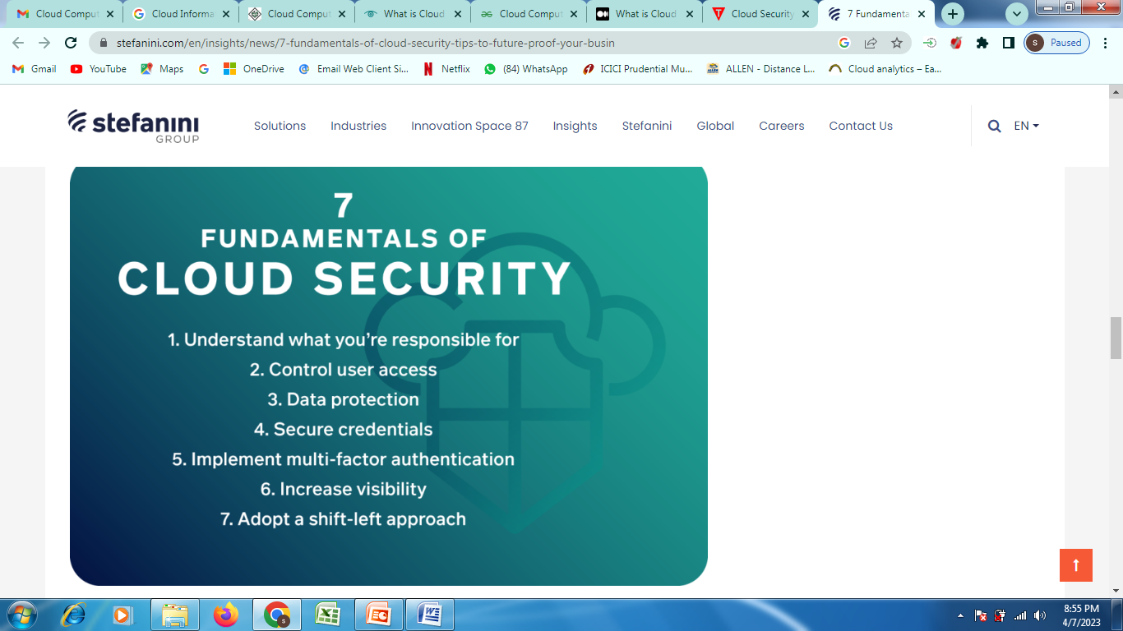
Cloud Security Cont….
Fundamentals of Cloud Security
Notes:
Tools for Functional Testing in Cloud
There are many tools used for testing performance, load, stress testing in or of cloud. Some of these testing tools are mentioned below:
AppPerfect: AppPerfect is a software development company located in Sunnyvale, CA. It markets supports and develops a set of testing and monitoring products that are used to analyze, test, and monitor web and windows-based applications.
Jmeter: Apache JMeter is an open-source, Java-based application software designed to load testing tools to analyze and monitor the performance of the services and web applications.
SOASTA CloudTest: SOASTA cloud test is a cross-platform test management tool with a user-friendly design.
LoadStorm: It is a tool to manage and monitor the performance of the entire cloud infrastructure and produces a real-time graph for performance analysis.
Tools for Security Testing in Cloud
The following are the tools for security testing in the cloud:
Nessus: Nessus is a remote security scanning tool that scans the system and raises an alert if any vulnerability is discovered that hackers could use to get unauthorized access to sensitive data.
Wireshark: Wireshark is an open-source packet analyzer used for network troubleshooting and monitoring, software, and communications protocols development.
Nmap: Nmap is a network scanner that is used to discover hosts and services on a network by sending packets and analyzing the response.
Benefits Of Cloud Testing
The following are some of the benefits of cloud testing:
Availability of Required testing environment: In cloud testing, testing teams can easily replicate the customer’s environment for effective testing of the cloud without investing in the additional hardware and software resources for testing. These resources can be accessed from any device with a network connection.
Less expensive: Cloud testing is more cost-efficient than traditional methods of testing, as there is no need of investing in additional hardware and software resources. Customers, as well as the testing team, only pay for what they use.
Faster testing: Cloud testing is faster than the traditional method of testing as most of the management tasks like physical infrastructure management for testing are removed.
Scalability: The cloud computing resources can be increased and decreased whenever required, based on testing demands.
Customization: Cloud testing can be customized as per the usage, cost and time based on the variety of users and user’s environment.
Disaster recovery: Disaster recovery is easily possible as the data backup is taken at the cloud vendors as well as at the user’s end also.

Slide 42
Cloud Security Cont….
1. Understand what you’re responsible for – different cloud services require varying levels of responsibility.
For instance, while software-as-a-service (SaaS) providers ensure that applications are protected and that data security is guaranteed, IaaS environments may not have the same controls.
To ensure security, cloud customers need to double check with their IaaS providers to understand who’s in charge of each security control.
Notes:
Tools for Functional Testing in Cloud
There are many tools used for testing performance, load, stress testing in or of cloud. Some of these testing tools are mentioned below:
AppPerfect: AppPerfect is a software development company located in Sunnyvale, CA. It markets supports and develops a set of testing and monitoring products that are used to analyze, test, and monitor web and windows-based applications.
Jmeter: Apache JMeter is an open-source, Java-based application software designed to load testing tools to analyze and monitor the performance of the services and web applications.
SOASTA CloudTest: SOASTA cloud test is a cross-platform test management tool with a user-friendly design.
LoadStorm: It is a tool to manage and monitor the performance of the entire cloud infrastructure and produces a real-time graph for performance analysis.
Tools for Security Testing in Cloud
The following are the tools for security testing in the cloud:
Nessus: Nessus is a remote security scanning tool that scans the system and raises an alert if any vulnerability is discovered that hackers could use to get unauthorized access to sensitive data.
Wireshark: Wireshark is an open-source packet analyzer used for network troubleshooting and monitoring, software, and communications protocols development.
Nmap: Nmap is a network scanner that is used to discover hosts and services on a network by sending packets and analyzing the response.
Benefits Of Cloud Testing
The following are some of the benefits of cloud testing:
Availability of Required testing environment: In cloud testing, testing teams can easily replicate the customer’s environment for effective testing of the cloud without investing in the additional hardware and software resources for testing. These resources can be accessed from any device with a network connection.
Less expensive: Cloud testing is more cost-efficient than traditional methods of testing, as there is no need of investing in additional hardware and software resources. Customers, as well as the testing team, only pay for what they use.
Faster testing: Cloud testing is faster than the traditional method of testing as most of the management tasks like physical infrastructure management for testing are removed.
Scalability: The cloud computing resources can be increased and decreased whenever required, based on testing demands.
Customization: Cloud testing can be customized as per the usage, cost and time based on the variety of users and user’s environment.
Disaster recovery: Disaster recovery is easily possible as the data backup is taken at the cloud vendors as well as at the user’s end also.

Slide 43
Cloud Security Cont….
2. Control user access – a huge challenge for enterprises has been controlling who has access to their cloud services. Too often, organizations accidently publically expose their cloud storage service despite warnings from cloud providers
CSO advises that only load balancers and bastion (defender) hosts should be exposed to the internet.
Further, do not allow Secure Shell (SSH) connections directly from the internet as this will allow anyone who finds the server location to bypass the firewall and directly access the data. Instead, use your cloud provider’s identity and access control tools while also knowing who has access to what data and when.
[The Secure Shell Protocol is a cryptographic network protocol for operating network services securely over an unsecured network. Its most notable applications are remote login and command-line execution. SSH applications are based on a client–server architecture, connecting an SSH client instance with an SSH server.]
Identity and access control policies should grant the minimum set of privileges needed and only grant other permissions as needed.
Finally, consider tools that let you set access controls based on user activity data.
Notes:
Tools for Functional Testing in Cloud
There are many tools used for testing performance, load, stress testing in or of cloud. Some of these testing tools are mentioned below:
AppPerfect: AppPerfect is a software development company located in Sunnyvale, CA. It markets supports and develops a set of testing and monitoring products that are used to analyze, test, and monitor web and windows-based applications.
Jmeter: Apache JMeter is an open-source, Java-based application software designed to load testing tools to analyze and monitor the performance of the services and web applications.
SOASTA CloudTest: SOASTA cloud test is a cross-platform test management tool with a user-friendly design.
LoadStorm: It is a tool to manage and monitor the performance of the entire cloud infrastructure and produces a real-time graph for performance analysis.
Tools for Security Testing in Cloud
The following are the tools for security testing in the cloud:
Nessus: Nessus is a remote security scanning tool that scans the system and raises an alert if any vulnerability is discovered that hackers could use to get unauthorized access to sensitive data.
Wireshark: Wireshark is an open-source packet analyzer used for network troubleshooting and monitoring, software, and communications protocols development.
Nmap: Nmap is a network scanner that is used to discover hosts and services on a network by sending packets and analyzing the response.
Benefits Of Cloud Testing
The following are some of the benefits of cloud testing:
Availability of Required testing environment: In cloud testing, testing teams can easily replicate the customer’s environment for effective testing of the cloud without investing in the additional hardware and software resources for testing. These resources can be accessed from any device with a network connection.
Less expensive: Cloud testing is more cost-efficient than traditional methods of testing, as there is no need of investing in additional hardware and software resources. Customers, as well as the testing team, only pay for what they use.
Faster testing: Cloud testing is faster than the traditional method of testing as most of the management tasks like physical infrastructure management for testing are removed.
Scalability: The cloud computing resources can be increased and decreased whenever required, based on testing demands.
Customization: Cloud testing can be customized as per the usage, cost and time based on the variety of users and user’s environment.
Disaster recovery: Disaster recovery is easily possible as the data backup is taken at the cloud vendors as well as at the user’s end also.

Slide 44
Cloud Security Cont….
3. Data protection – data stored on cloud infrastructures should never be unencrypted. Even though you can hand the keys over to cloud service providers, it is still your responsibility to protect your data.
4. Secure credentials – AWS access keys can be exposed on public websites, source code repositories, unprotected Kubernetes dashboards, and other such platforms.
Therefore, you should create and regularly rotate keys for each external service.
Never use root user accounts – these accounts should only be used for specific account and service management tasks.
Further, disable any user accounts that aren’t being used to further limit potential paths that hackers can compromise.
5. Implement MFA – your security controls should be so rigorous that if one control fails, other features keep the application, network, and data in the cloud safe. By tying MFA (multi-factor authentication) to usernames and passwords, attackers have an even harder time breaking in. Use MFA to limit access to management consoles, dashboards, and privileged accounts.
Notes:
Tools for Functional Testing in Cloud
There are many tools used for testing performance, load, stress testing in or of cloud. Some of these testing tools are mentioned below:
AppPerfect: AppPerfect is a software development company located in Sunnyvale, CA. It markets supports and develops a set of testing and monitoring products that are used to analyze, test, and monitor web and windows-based applications.
Jmeter: Apache JMeter is an open-source, Java-based application software designed to load testing tools to analyze and monitor the performance of the services and web applications.
SOASTA CloudTest: SOASTA cloud test is a cross-platform test management tool with a user-friendly design.
LoadStorm: It is a tool to manage and monitor the performance of the entire cloud infrastructure and produces a real-time graph for performance analysis.
Tools for Security Testing in Cloud
The following are the tools for security testing in the cloud:
Nessus: Nessus is a remote security scanning tool that scans the system and raises an alert if any vulnerability is discovered that hackers could use to get unauthorized access to sensitive data.
Wireshark: Wireshark is an open-source packet analyzer used for network troubleshooting and monitoring, software, and communications protocols development.
Nmap: Nmap is a network scanner that is used to discover hosts and services on a network by sending packets and analyzing the response.
Benefits Of Cloud Testing
The following are some of the benefits of cloud testing:
Availability of Required testing environment: In cloud testing, testing teams can easily replicate the customer’s environment for effective testing of the cloud without investing in the additional hardware and software resources for testing. These resources can be accessed from any device with a network connection.
Less expensive: Cloud testing is more cost-efficient than traditional methods of testing, as there is no need of investing in additional hardware and software resources. Customers, as well as the testing team, only pay for what they use.
Faster testing: Cloud testing is faster than the traditional method of testing as most of the management tasks like physical infrastructure management for testing are removed.
Scalability: The cloud computing resources can be increased and decreased whenever required, based on testing demands.
Customization: Cloud testing can be customized as per the usage, cost and time based on the variety of users and user’s environment.
Disaster recovery: Disaster recovery is easily possible as the data backup is taken at the cloud vendors as well as at the user’s end also.

Slide 45
Cloud Security Cont….
6. Increase visibility – to see issues like unauthorized access attempts, turn on security logging and monitoring once your cloud has been set up. Major cloud providers supply some level of logging tools that can be used for change tracking, resource management, security analysis, and compliance audits.
7. Adopt a shift–left approach – with a shift-left approach, security considerations are incorporated early into the development process rather than at the final stage.
Before an IaaS platform goes live, enterprises need to check all the code going into the platform while also auditing and catching potential misconfigurations before they happen.
Automate the auditing and correction process by choosing security solutions that integrate with Jenkins, Kubernetes, and others.
Check that workloads are compliant (obedient) before they’re put into production.
Continuously monitoring your cloud environment is key here.
Notes:
Tools for Functional Testing in Cloud
There are many tools used for testing performance, load, stress testing in or of cloud. Some of these testing tools are mentioned below:
AppPerfect: AppPerfect is a software development company located in Sunnyvale, CA. It markets supports and develops a set of testing and monitoring products that are used to analyze, test, and monitor web and windows-based applications.
Jmeter: Apache JMeter is an open-source, Java-based application software designed to load testing tools to analyze and monitor the performance of the services and web applications.
SOASTA CloudTest: SOASTA cloud test is a cross-platform test management tool with a user-friendly design.
LoadStorm: It is a tool to manage and monitor the performance of the entire cloud infrastructure and produces a real-time graph for performance analysis.
Tools for Security Testing in Cloud
The following are the tools for security testing in the cloud:
Nessus: Nessus is a remote security scanning tool that scans the system and raises an alert if any vulnerability is discovered that hackers could use to get unauthorized access to sensitive data.
Wireshark: Wireshark is an open-source packet analyzer used for network troubleshooting and monitoring, software, and communications protocols development.
Nmap: Nmap is a network scanner that is used to discover hosts and services on a network by sending packets and analyzing the response.
Benefits Of Cloud Testing
The following are some of the benefits of cloud testing:
Availability of Required testing environment: In cloud testing, testing teams can easily replicate the customer’s environment for effective testing of the cloud without investing in the additional hardware and software resources for testing. These resources can be accessed from any device with a network connection.
Less expensive: Cloud testing is more cost-efficient than traditional methods of testing, as there is no need of investing in additional hardware and software resources. Customers, as well as the testing team, only pay for what they use.
Faster testing: Cloud testing is faster than the traditional method of testing as most of the management tasks like physical infrastructure management for testing are removed.
Scalability: The cloud computing resources can be increased and decreased whenever required, based on testing demands.
Customization: Cloud testing can be customized as per the usage, cost and time based on the variety of users and user’s environment.
Disaster recovery: Disaster recovery is easily possible as the data backup is taken at the cloud vendors as well as at the user’s end also.

Slide 46
Cloud security services
What types of cloud security solutions are available?
Identity and access management (IAM): The core functionality of IAM is to create digital identities for all users so they can be actively monitored and restricted when necessary during all data interactions
Data loss prevention (DLP): DLP solutions use a combination of remediation alerts, data encryption, and other preventative measures to protect all stored data, whether at rest or in motion.
Security information and event management (SIEM): Security information and event management (SIEM) provides a comprehensive security orchestration solution that automates threat monitoring, detection, and response in cloud-based environments. Using artificial intelligence (AI)-driven technologies to correlate log data across multiple platforms and digital assets, SIEM technology gives IT teams the ability to successfully apply their network security protocols while being able to quickly react to any potential threats.
Business continuity and disaster recovery: Regardless of the preventative measures organizations have in place for their on-premise and cloud-based infrastructures, data breaches and disruptive outages can still occur. Disaster recovery solutions are a staple (clip) in cloud security and provide organizations with the tools, services, and protocols necessary to expedite the recovery of lost data and resume normal business operations.
Notes:
Tools for Functional Testing in Cloud
There are many tools used for testing performance, load, stress testing in or of cloud. Some of these testing tools are mentioned below:
AppPerfect: AppPerfect is a software development company located in Sunnyvale, CA. It markets supports and develops a set of testing and monitoring products that are used to analyze, test, and monitor web and windows-based applications.
Jmeter: Apache JMeter is an open-source, Java-based application software designed to load testing tools to analyze and monitor the performance of the services and web applications.
SOASTA CloudTest: SOASTA cloud test is a cross-platform test management tool with a user-friendly design.
LoadStorm: It is a tool to manage and monitor the performance of the entire cloud infrastructure and produces a real-time graph for performance analysis.
Tools for Security Testing in Cloud
The following are the tools for security testing in the cloud:
Nessus: Nessus is a remote security scanning tool that scans the system and raises an alert if any vulnerability is discovered that hackers could use to get unauthorized access to sensitive data.
Wireshark: Wireshark is an open-source packet analyzer used for network troubleshooting and monitoring, software, and communications protocols development.
Nmap: Nmap is a network scanner that is used to discover hosts and services on a network by sending packets and analyzing the response.
Benefits Of Cloud Testing
The following are some of the benefits of cloud testing:
Availability of Required testing environment: In cloud testing, testing teams can easily replicate the customer’s environment for effective testing of the cloud without investing in the additional hardware and software resources for testing. These resources can be accessed from any device with a network connection.
Less expensive: Cloud testing is more cost-efficient than traditional methods of testing, as there is no need of investing in additional hardware and software resources. Customers, as well as the testing team, only pay for what they use.
Faster testing: Cloud testing is faster than the traditional method of testing as most of the management tasks like physical infrastructure management for testing are removed.
Scalability: The cloud computing resources can be increased and decreased whenever required, based on testing demands.
Customization: Cloud testing can be customized as per the usage, cost and time based on the variety of users and user’s environment.
Disaster recovery: Disaster recovery is easily possible as the data backup is taken at the cloud vendors as well as at the user’s end also.

Slide 47
Cloud Computing Security Architecture
A cloud security architecture (also sometimes called a “cloud computing security architecture”) is defined by the security layers, design, and structure of the platform, tools, software, infrastructure, and best practices that exist within a cloud security solution.
A cloud security architecture provides the written and visual model to define how to configure and secure activities and operations within the cloud, including such things as identity and access management; methods and controls to protect applications and data; approaches to gain and maintain visibility into compliance, threat posture, and overall security; processes for instilling security principles into cloud services development and operations; policies and governance to meet compliance standards; and physical infrastructure security components.
Key Elements of a Cloud Security Architecture: When developing a cloud security architecture several critical elements should be included:
Security at Each Layer
Centralized Management of Components
Redundant & Resilient Design
Elasticity & Scalability
Appropriate Storage for Deployments
Alerts & Notifications
Notes:
Tools for Functional Testing in Cloud
There are many tools used for testing performance, load, stress testing in or of cloud. Some of these testing tools are mentioned below:
AppPerfect: AppPerfect is a software development company located in Sunnyvale, CA. It markets supports and develops a set of testing and monitoring products that are used to analyze, test, and monitor web and windows-based applications.
Jmeter: Apache JMeter is an open-source, Java-based application software designed to load testing tools to analyze and monitor the performance of the services and web applications.
SOASTA CloudTest: SOASTA cloud test is a cross-platform test management tool with a user-friendly design.
LoadStorm: It is a tool to manage and monitor the performance of the entire cloud infrastructure and produces a real-time graph for performance analysis.
Tools for Security Testing in Cloud
The following are the tools for security testing in the cloud:
Nessus: Nessus is a remote security scanning tool that scans the system and raises an alert if any vulnerability is discovered that hackers could use to get unauthorized access to sensitive data.
Wireshark: Wireshark is an open-source packet analyzer used for network troubleshooting and monitoring, software, and communications protocols development.
Nmap: Nmap is a network scanner that is used to discover hosts and services on a network by sending packets and analyzing the response.
Benefits Of Cloud Testing
The following are some of the benefits of cloud testing:
Availability of Required testing environment: In cloud testing, testing teams can easily replicate the customer’s environment for effective testing of the cloud without investing in the additional hardware and software resources for testing. These resources can be accessed from any device with a network connection.
Less expensive: Cloud testing is more cost-efficient than traditional methods of testing, as there is no need of investing in additional hardware and software resources. Customers, as well as the testing team, only pay for what they use.
Faster testing: Cloud testing is faster than the traditional method of testing as most of the management tasks like physical infrastructure management for testing are removed.
Scalability: The cloud computing resources can be increased and decreased whenever required, based on testing demands.
Customization: Cloud testing can be customized as per the usage, cost and time based on the variety of users and user’s environment.
Disaster recovery: Disaster recovery is easily possible as the data backup is taken at the cloud vendors as well as at the user’s end also.

Slide 48
Cloud Computing Security Architecture Cont….
The hardware and technology used to safeguard data, workloads, and systems on cloud platforms is called Cloud Security Architecture.
Cloud security architecture is a framework that includes all of the technology and software required to safeguard information, data, and applications handled in or through the cloud. Public clouds, private clouds, and hybrid clouds are some of the cloud computing frameworks.
Developing a cloud security architecture plan should start with the blueprint and design process, and it should be built into cloud platforms from the ground up.
Cloud security architecture can close security gaps that go undiscovered in traditional point-of-sale (POS) [A POS system allows your business to accept payments from customers and keep track of sales.] systems. In addition, cloud security design eliminates security network redundancy difficulties. It also aids in the organization of security measures while ensuring their reliability throughout data processing. A suitable cloud security architecture can also handle complex security issues successfully.
Cloud security architecture allows businesses to take advantage of all that the cloud offers—including software as a service (SaaS), platform as a service (PaaS), and infrastructure as a service (IaaS) offerings—while mitigating (reduce) exposure and vulnerability. Without cloud security architecture, the risks associated with using the cloud could outweigh any potential benefit.
Notes:
Tools for Functional Testing in Cloud
There are many tools used for testing performance, load, stress testing in or of cloud. Some of these testing tools are mentioned below:
AppPerfect: AppPerfect is a software development company located in Sunnyvale, CA. It markets supports and develops a set of testing and monitoring products that are used to analyze, test, and monitor web and windows-based applications.
Jmeter: Apache JMeter is an open-source, Java-based application software designed to load testing tools to analyze and monitor the performance of the services and web applications.
SOASTA CloudTest: SOASTA cloud test is a cross-platform test management tool with a user-friendly design.
LoadStorm: It is a tool to manage and monitor the performance of the entire cloud infrastructure and produces a real-time graph for performance analysis.
Tools for Security Testing in Cloud
The following are the tools for security testing in the cloud:
Nessus: Nessus is a remote security scanning tool that scans the system and raises an alert if any vulnerability is discovered that hackers could use to get unauthorized access to sensitive data.
Wireshark: Wireshark is an open-source packet analyzer used for network troubleshooting and monitoring, software, and communications protocols development.
Nmap: Nmap is a network scanner that is used to discover hosts and services on a network by sending packets and analyzing the response.
Benefits Of Cloud Testing
The following are some of the benefits of cloud testing:
Availability of Required testing environment: In cloud testing, testing teams can easily replicate the customer’s environment for effective testing of the cloud without investing in the additional hardware and software resources for testing. These resources can be accessed from any device with a network connection.
Less expensive: Cloud testing is more cost-efficient than traditional methods of testing, as there is no need of investing in additional hardware and software resources. Customers, as well as the testing team, only pay for what they use.
Faster testing: Cloud testing is faster than the traditional method of testing as most of the management tasks like physical infrastructure management for testing are removed.
Scalability: The cloud computing resources can be increased and decreased whenever required, based on testing demands.
Customization: Cloud testing can be customized as per the usage, cost and time based on the variety of users and user’s environment.
Disaster recovery: Disaster recovery is easily possible as the data backup is taken at the cloud vendors as well as at the user’s end also.

Slide 49
Cloud Computing Security Architecture Cont….
Cloud Security Core Capabilities
Secure cloud computing architecture encompasses three core capabilities: confidentiality, integrity, and availability
Confidentiality is the ability to keep information secret and unreadable to the people who shouldn’t have access to that data, such as attackers or people inside an organization without the proper access level. Confidentiality also includes privacy and trust, or when a business pledges secrecy in handling their customers’ data.
Integrity is the idea that the systems and applications are exactly what you expect them to be, and function exactly as you expect them to function. If a system or application has been compromised to produce an unknown, unexpected, or misleading output, this can lead to losses.
Availability is the third capability and is generally the least considered by cloud architects. Availability speaks to denial-of-service (DoS) attacks. Perhaps an attacker can’t see or change your data. But if an attacker can make systems unavailable to you or your customers, then you can’t carry out tasks that are essential to maintain your business.
Notes:
Tools for Functional Testing in Cloud
There are many tools used for testing performance, load, stress testing in or of cloud. Some of these testing tools are mentioned below:
AppPerfect: AppPerfect is a software development company located in Sunnyvale, CA. It markets supports and develops a set of testing and monitoring products that are used to analyze, test, and monitor web and windows-based applications.
Jmeter: Apache JMeter is an open-source, Java-based application software designed to load testing tools to analyze and monitor the performance of the services and web applications.
SOASTA CloudTest: SOASTA cloud test is a cross-platform test management tool with a user-friendly design.
LoadStorm: It is a tool to manage and monitor the performance of the entire cloud infrastructure and produces a real-time graph for performance analysis.
Tools for Security Testing in Cloud
The following are the tools for security testing in the cloud:
Nessus: Nessus is a remote security scanning tool that scans the system and raises an alert if any vulnerability is discovered that hackers could use to get unauthorized access to sensitive data.
Wireshark: Wireshark is an open-source packet analyzer used for network troubleshooting and monitoring, software, and communications protocols development.
Nmap: Nmap is a network scanner that is used to discover hosts and services on a network by sending packets and analyzing the response.
Benefits Of Cloud Testing
The following are some of the benefits of cloud testing:
Availability of Required testing environment: In cloud testing, testing teams can easily replicate the customer’s environment for effective testing of the cloud without investing in the additional hardware and software resources for testing. These resources can be accessed from any device with a network connection.
Less expensive: Cloud testing is more cost-efficient than traditional methods of testing, as there is no need of investing in additional hardware and software resources. Customers, as well as the testing team, only pay for what they use.
Faster testing: Cloud testing is faster than the traditional method of testing as most of the management tasks like physical infrastructure management for testing are removed.
Scalability: The cloud computing resources can be increased and decreased whenever required, based on testing demands.
Customization: Cloud testing can be customized as per the usage, cost and time based on the variety of users and user’s environment.
Disaster recovery: Disaster recovery is easily possible as the data backup is taken at the cloud vendors as well as at the user’s end also.

Slide 50
Cloud Computing Security Architecture Cont….
Secure Cloud Computing in Practice
There are numerous tools to address confidentiality, integrity, and availability in cloud platforms with the end goal of defining a trusted execution environment (TEE).
Encryption protects text and data by translating it into ciphers that only authorized parties have the ability to decipher, access, and edit.
Firmware resilience is about helping to prevent attacks to the firmware layer but also includes recovering from an attack and restoring the system back to a known good state.
Establishing a root of trust includes boot integrity, which helps protect the system from malware injections during system startup.
Stack validation seeks to establish that all components and software within a system stack have been validated and are not compromised or changed, either before delivery, in transit to cloud architects, or during deployment.
Secure systems are designed to isolate virtual machines (VMs), containers, data, and applications from each other as a key best practice.
Notes:
Tools for Functional Testing in Cloud
There are many tools used for testing performance, load, stress testing in or of cloud. Some of these testing tools are mentioned below:
AppPerfect: AppPerfect is a software development company located in Sunnyvale, CA. It markets supports and develops a set of testing and monitoring products that are used to analyze, test, and monitor web and windows-based applications.
Jmeter: Apache JMeter is an open-source, Java-based application software designed to load testing tools to analyze and monitor the performance of the services and web applications.
SOASTA CloudTest: SOASTA cloud test is a cross-platform test management tool with a user-friendly design.
LoadStorm: It is a tool to manage and monitor the performance of the entire cloud infrastructure and produces a real-time graph for performance analysis.
Tools for Security Testing in Cloud
The following are the tools for security testing in the cloud:
Nessus: Nessus is a remote security scanning tool that scans the system and raises an alert if any vulnerability is discovered that hackers could use to get unauthorized access to sensitive data.
Wireshark: Wireshark is an open-source packet analyzer used for network troubleshooting and monitoring, software, and communications protocols development.
Nmap: Nmap is a network scanner that is used to discover hosts and services on a network by sending packets and analyzing the response.
Benefits Of Cloud Testing
The following are some of the benefits of cloud testing:
Availability of Required testing environment: In cloud testing, testing teams can easily replicate the customer’s environment for effective testing of the cloud without investing in the additional hardware and software resources for testing. These resources can be accessed from any device with a network connection.
Less expensive: Cloud testing is more cost-efficient than traditional methods of testing, as there is no need of investing in additional hardware and software resources. Customers, as well as the testing team, only pay for what they use.
Faster testing: Cloud testing is faster than the traditional method of testing as most of the management tasks like physical infrastructure management for testing are removed.
Scalability: The cloud computing resources can be increased and decreased whenever required, based on testing demands.
Customization: Cloud testing can be customized as per the usage, cost and time based on the variety of users and user’s environment.
Disaster recovery: Disaster recovery is easily possible as the data backup is taken at the cloud vendors as well as at the user’s end also.

Slide 51
Cloud Computing Security Architecture Cont….
Threats to a Cloud Security Architecture
While planning your cloud deployment, you want to be prepared for common threats such as malware and privilege-based attacks [progressively increase their access to computer systems by exploiting its security vulnerabilities.]. There are too many common threats to enumerate here:
Insider threats include both workers within your own organization who have access to systems and data and also cloud service provider (CSP) administrators. When you subscribe to CSP services, you are essentially entrusting your data and workloads to the multitude of staff who are responsible for maintaining the CSP architecture.
Another consideration is whether data is accessible to governmental entities. Security experts are paying more attention to the laws, regulations, and real-life practices that demonstrate whether a government can use court orders or other means to gain access to data in a private or public cloud.
DoS attacks: Temporary direct denial-of-service (DDoS) attacks typically involve hammering a system with requests until it shuts down.
Permanent DoS attacks are more destructive and often inflict damage at the firmware level to render a server unbootable. In this case, a technician needs to physically reload the firmware and rebuild the system from scratch, which can result in servers being shut down for days or weeks.
Notes:
Tools for Functional Testing in Cloud
There are many tools used for testing performance, load, stress testing in or of cloud. Some of these testing tools are mentioned below:
AppPerfect: AppPerfect is a software development company located in Sunnyvale, CA. It markets supports and develops a set of testing and monitoring products that are used to analyze, test, and monitor web and windows-based applications.
Jmeter: Apache JMeter is an open-source, Java-based application software designed to load testing tools to analyze and monitor the performance of the services and web applications.
SOASTA CloudTest: SOASTA cloud test is a cross-platform test management tool with a user-friendly design.
LoadStorm: It is a tool to manage and monitor the performance of the entire cloud infrastructure and produces a real-time graph for performance analysis.
Tools for Security Testing in Cloud
The following are the tools for security testing in the cloud:
Nessus: Nessus is a remote security scanning tool that scans the system and raises an alert if any vulnerability is discovered that hackers could use to get unauthorized access to sensitive data.
Wireshark: Wireshark is an open-source packet analyzer used for network troubleshooting and monitoring, software, and communications protocols development.
Nmap: Nmap is a network scanner that is used to discover hosts and services on a network by sending packets and analyzing the response.
Benefits Of Cloud Testing
The following are some of the benefits of cloud testing:
Availability of Required testing environment: In cloud testing, testing teams can easily replicate the customer’s environment for effective testing of the cloud without investing in the additional hardware and software resources for testing. These resources can be accessed from any device with a network connection.
Less expensive: Cloud testing is more cost-efficient than traditional methods of testing, as there is no need of investing in additional hardware and software resources. Customers, as well as the testing team, only pay for what they use.
Faster testing: Cloud testing is faster than the traditional method of testing as most of the management tasks like physical infrastructure management for testing are removed.
Scalability: The cloud computing resources can be increased and decreased whenever required, based on testing demands.
Customization: Cloud testing can be customized as per the usage, cost and time based on the variety of users and user’s environment.
Disaster recovery: Disaster recovery is easily possible as the data backup is taken at the cloud vendors as well as at the user’s end also.

Slide 52
Cloud Computing Security Architecture Cont….
Threats to a Cloud Security Architecture Cont…..
The cloud edge can refer to cloud-connected edge systems, but for a CSP it also refers to server architecture that is not under the CSP’s direct control. Global CSPs cannot build and run their own facilities in every corner of the planet, so they rely on partners to deliver services to smaller, geographically isolated, or rural regions. As a result, these CSPs don’t have total control to monitor and ensure physical box integrity for the hardware or physical attack protections such as locking down access to USB ports.
Customer control influences how customers evaluate public cloud offerings. From the customer perspective, users are nervous about moving sensitive workloads to the public cloud. On the other hand, big cloud providers are typically much better equipped and have a much higher level of expertise in cloud security than the average enterprise running a private cloud. Generally, customers find it reassuring to be in total control of their most sensitive data, even if their security tools aren’t as sophisticated.
Hardware limitations mean that even with the most robust cloud security architecture in the world, a server can’t help you create a better password. Passwords are one of the most common vectors of attack. Cloud security architects are focused on hardware, firmware, and software protections, but it will still fall on the shoulders of everyday users to follow best practices.
Notes:
Tools for Functional Testing in Cloud
There are many tools used for testing performance, load, stress testing in or of cloud. Some of these testing tools are mentioned below:
AppPerfect: AppPerfect is a software development company located in Sunnyvale, CA. It markets supports and develops a set of testing and monitoring products that are used to analyze, test, and monitor web and windows-based applications.
Jmeter: Apache JMeter is an open-source, Java-based application software designed to load testing tools to analyze and monitor the performance of the services and web applications.
SOASTA CloudTest: SOASTA cloud test is a cross-platform test management tool with a user-friendly design.
LoadStorm: It is a tool to manage and monitor the performance of the entire cloud infrastructure and produces a real-time graph for performance analysis.
Tools for Security Testing in Cloud
The following are the tools for security testing in the cloud:
Nessus: Nessus is a remote security scanning tool that scans the system and raises an alert if any vulnerability is discovered that hackers could use to get unauthorized access to sensitive data.
Wireshark: Wireshark is an open-source packet analyzer used for network troubleshooting and monitoring, software, and communications protocols development.
Nmap: Nmap is a network scanner that is used to discover hosts and services on a network by sending packets and analyzing the response.
Benefits Of Cloud Testing
The following are some of the benefits of cloud testing:
Availability of Required testing environment: In cloud testing, testing teams can easily replicate the customer’s environment for effective testing of the cloud without investing in the additional hardware and software resources for testing. These resources can be accessed from any device with a network connection.
Less expensive: Cloud testing is more cost-efficient than traditional methods of testing, as there is no need of investing in additional hardware and software resources. Customers, as well as the testing team, only pay for what they use.
Faster testing: Cloud testing is faster than the traditional method of testing as most of the management tasks like physical infrastructure management for testing are removed.
Scalability: The cloud computing resources can be increased and decreased whenever required, based on testing demands.
Customization: Cloud testing can be customized as per the usage, cost and time based on the variety of users and user’s environment.
Disaster recovery: Disaster recovery is easily possible as the data backup is taken at the cloud vendors as well as at the user’s end also.

Slide 53
Cloud Computing Security Architecture Cont….
Threats to a Cloud Security Architecture Cont…..
Some threats and issues may also be more specific to the type of cloud service:
SaaS Cloud Security Threats
Weak or immature identity and access management
Weak cloud security standards
Zero-day vulnerabilities
Shadow IT/unsanctioned cloud applications/software
Service disruption through denial-of-service attacks
Phishing
Credential stuffing attacks
Weak compliance and auditing oversight
Stolen or compromised credentials
Weak vulnerability monitoring
PaaS Cloud Security Threats
Privilege escalation via API
Authorization weaknesses in platform services
Run-time engine vulnerabilities
Availability disruption through denial-of-service attacks
Injection flaws
Broken authentication
Sensitive data exposure
XML external entities
Broken access control
Security misconfigurations
Cross-site scripting (XSS)
Insecure deserialization
Using components with known vulnerabilities
Insufficient logging and monitoring
Data leakage (through inadequate ACL)
Privilege escalation through misconfiguration
DoS attack via API
Privilege escalation via API
Weak privileged key protection
Virtual machine (VM) weaknesses
Insider data theft
IaaS Cloud Security Threats
Availability disruption through denial-of-service attacks
Injection flaws
Broken authentication
Sensitive data exposure
XML external entities
Broken access control
Security misconfigurations
Cross-site scripting (XSS)
Insecure deserialization
Using components with known vulnerabilities
Insufficient logging and monitoring
Data leakage (through inadequate ACL)
Privilege escalation through misconfiguration
DoS attack via API
Weak privileged key protection
Virtual machine (VM) weaknesses
Insider data theft
Notes:
Tools for Functional Testing in Cloud
There are many tools used for testing performance, load, stress testing in or of cloud. Some of these testing tools are mentioned below:
AppPerfect: AppPerfect is a software development company located in Sunnyvale, CA. It markets supports and develops a set of testing and monitoring products that are used to analyze, test, and monitor web and windows-based applications.
Jmeter: Apache JMeter is an open-source, Java-based application software designed to load testing tools to analyze and monitor the performance of the services and web applications.
SOASTA CloudTest: SOASTA cloud test is a cross-platform test management tool with a user-friendly design.
LoadStorm: It is a tool to manage and monitor the performance of the entire cloud infrastructure and produces a real-time graph for performance analysis.
Tools for Security Testing in Cloud
The following are the tools for security testing in the cloud:
Nessus: Nessus is a remote security scanning tool that scans the system and raises an alert if any vulnerability is discovered that hackers could use to get unauthorized access to sensitive data.
Wireshark: Wireshark is an open-source packet analyzer used for network troubleshooting and monitoring, software, and communications protocols development.
Nmap: Nmap is a network scanner that is used to discover hosts and services on a network by sending packets and analyzing the response.
Benefits Of Cloud Testing
The following are some of the benefits of cloud testing:
Availability of Required testing environment: In cloud testing, testing teams can easily replicate the customer’s environment for effective testing of the cloud without investing in the additional hardware and software resources for testing. These resources can be accessed from any device with a network connection.
Less expensive: Cloud testing is more cost-efficient than traditional methods of testing, as there is no need of investing in additional hardware and software resources. Customers, as well as the testing team, only pay for what they use.
Faster testing: Cloud testing is faster than the traditional method of testing as most of the management tasks like physical infrastructure management for testing are removed.
Scalability: The cloud computing resources can be increased and decreased whenever required, based on testing demands.
Customization: Cloud testing can be customized as per the usage, cost and time based on the variety of users and user’s environment.
Disaster recovery: Disaster recovery is easily possible as the data backup is taken at the cloud vendors as well as at the user’s end also.

Slide 54
Cloud Computing Security Architecture Cont….
Cloud Security Architectures by Service Model
For cloud architects, the tools to help build confidentiality, integrity, and availability across SaaS, PaaS, and IaaS are essentially the same and include encryption, firmware resilience, stack validation, and establishing a root of trust.
Organizations that offer cloud services typically adhere to a shared responsibility model—that is, the cloud service provider is responsible for the security of the components necessary to operate the cloud service (software, computing, storage, database, networking, hardware, infrastructure, etc.).
The customer is responsible for protecting the data and information that is stored in the cloud, as well as how they may access that data (identity and access management). Responsibilities vary slightly depending on the type of service (IaaS, SaaS, or PaaS).
The types of service models in use by a business define the types of cloud security architectures that are most applicable. The service models are: Infrastructure as a Service (IaaS), Software as a Service (SaaS), and Platform as a Service (PaaS).
Notes:
Tools for Functional Testing in Cloud
There are many tools used for testing performance, load, stress testing in or of cloud. Some of these testing tools are mentioned below:
AppPerfect: AppPerfect is a software development company located in Sunnyvale, CA. It markets supports and develops a set of testing and monitoring products that are used to analyze, test, and monitor web and windows-based applications.
Jmeter: Apache JMeter is an open-source, Java-based application software designed to load testing tools to analyze and monitor the performance of the services and web applications.
SOASTA CloudTest: SOASTA cloud test is a cross-platform test management tool with a user-friendly design.
LoadStorm: It is a tool to manage and monitor the performance of the entire cloud infrastructure and produces a real-time graph for performance analysis.
Tools for Security Testing in Cloud
The following are the tools for security testing in the cloud:
Nessus: Nessus is a remote security scanning tool that scans the system and raises an alert if any vulnerability is discovered that hackers could use to get unauthorized access to sensitive data.
Wireshark: Wireshark is an open-source packet analyzer used for network troubleshooting and monitoring, software, and communications protocols development.
Nmap: Nmap is a network scanner that is used to discover hosts and services on a network by sending packets and analyzing the response.
Benefits Of Cloud Testing
The following are some of the benefits of cloud testing:
Availability of Required testing environment: In cloud testing, testing teams can easily replicate the customer’s environment for effective testing of the cloud without investing in the additional hardware and software resources for testing. These resources can be accessed from any device with a network connection.
Less expensive: Cloud testing is more cost-efficient than traditional methods of testing, as there is no need of investing in additional hardware and software resources. Customers, as well as the testing team, only pay for what they use.
Faster testing: Cloud testing is faster than the traditional method of testing as most of the management tasks like physical infrastructure management for testing are removed.
Scalability: The cloud computing resources can be increased and decreased whenever required, based on testing demands.
Customization: Cloud testing can be customized as per the usage, cost and time based on the variety of users and user’s environment.
Disaster recovery: Disaster recovery is easily possible as the data backup is taken at the cloud vendors as well as at the user’s end also.

Slide 55
Cloud Computing Security Architecture Cont….
Cloud Security Architectures by Service Mode Cont…
The types of service models in use by a business define the types of cloud security architectures that are most applicable. Responsibilities vary slightly depending on the type of service (IaaS, SaaS, or PaaS).
PaaS Cloud Security Architecture Components: PaaS providers must pay attention to multiparty usage and establish trust in moving data to and from the platform.
With a PaaS, a business purchases a platform from a cloud provider to develop, run, and manage applications without developing or managing the underlying platform infrastructure required for the applications. An example of a PaaS would be Amazon Web Services (AWS). In a PaaS, the customer is responsible for the security associated with application implementation, configurations, and permissions.
A PaaS security architecturemay require both standard cloud security architecture solutions, as well as less common solutions, such as a Cloud Workload Protection Platform (CWPP).
Notes:
Tools for Functional Testing in Cloud
There are many tools used for testing performance, load, stress testing in or of cloud. Some of these testing tools are mentioned below:
AppPerfect: AppPerfect is a software development company located in Sunnyvale, CA. It markets supports and develops a set of testing and monitoring products that are used to analyze, test, and monitor web and windows-based applications.
Jmeter: Apache JMeter is an open-source, Java-based application software designed to load testing tools to analyze and monitor the performance of the services and web applications.
SOASTA CloudTest: SOASTA cloud test is a cross-platform test management tool with a user-friendly design.
LoadStorm: It is a tool to manage and monitor the performance of the entire cloud infrastructure and produces a real-time graph for performance analysis.
Tools for Security Testing in Cloud
The following are the tools for security testing in the cloud:
Nessus: Nessus is a remote security scanning tool that scans the system and raises an alert if any vulnerability is discovered that hackers could use to get unauthorized access to sensitive data.
Wireshark: Wireshark is an open-source packet analyzer used for network troubleshooting and monitoring, software, and communications protocols development.
Nmap: Nmap is a network scanner that is used to discover hosts and services on a network by sending packets and analyzing the response.
Benefits Of Cloud Testing
The following are some of the benefits of cloud testing:
Availability of Required testing environment: In cloud testing, testing teams can easily replicate the customer’s environment for effective testing of the cloud without investing in the additional hardware and software resources for testing. These resources can be accessed from any device with a network connection.
Less expensive: Cloud testing is more cost-efficient than traditional methods of testing, as there is no need of investing in additional hardware and software resources. Customers, as well as the testing team, only pay for what they use.
Faster testing: Cloud testing is faster than the traditional method of testing as most of the management tasks like physical infrastructure management for testing are removed.
Scalability: The cloud computing resources can be increased and decreased whenever required, based on testing demands.
Customization: Cloud testing can be customized as per the usage, cost and time based on the variety of users and user’s environment.
Disaster recovery: Disaster recovery is easily possible as the data backup is taken at the cloud vendors as well as at the user’s end also.

Slide 56
Cloud Computing Security Architecture Cont….
Cloud Security Architectures by Service Mode Cont…
IaaS Cloud Security Architecture Components: IaaS providers must focus on runtime encryption and orchestration capabilities that empower customers to manage key encryption for any application they use in the cloud.
With an IaaS, a business purchases the infrastructure from a cloud provider and the business typically installs their own operating systems, applications, and middleware. An example of an IaaS is Azure (Microsoft). In an IaaS, the customer is usually responsible for the security associated with anything they own or install on the infrastructure.
Security architecture components in an IaaS cloud environment may include endpoint protection (EPP), a cloud access security broker (CASB), a vulnerability management solution, access management, and data and network encryption.
Notes:
Tools for Functional Testing in Cloud
There are many tools used for testing performance, load, stress testing in or of cloud. Some of these testing tools are mentioned below:
AppPerfect: AppPerfect is a software development company located in Sunnyvale, CA. It markets supports and develops a set of testing and monitoring products that are used to analyze, test, and monitor web and windows-based applications.
Jmeter: Apache JMeter is an open-source, Java-based application software designed to load testing tools to analyze and monitor the performance of the services and web applications.
SOASTA CloudTest: SOASTA cloud test is a cross-platform test management tool with a user-friendly design.
LoadStorm: It is a tool to manage and monitor the performance of the entire cloud infrastructure and produces a real-time graph for performance analysis.
Tools for Security Testing in Cloud
The following are the tools for security testing in the cloud:
Nessus: Nessus is a remote security scanning tool that scans the system and raises an alert if any vulnerability is discovered that hackers could use to get unauthorized access to sensitive data.
Wireshark: Wireshark is an open-source packet analyzer used for network troubleshooting and monitoring, software, and communications protocols development.
Nmap: Nmap is a network scanner that is used to discover hosts and services on a network by sending packets and analyzing the response.
Benefits Of Cloud Testing
The following are some of the benefits of cloud testing:
Availability of Required testing environment: In cloud testing, testing teams can easily replicate the customer’s environment for effective testing of the cloud without investing in the additional hardware and software resources for testing. These resources can be accessed from any device with a network connection.
Less expensive: Cloud testing is more cost-efficient than traditional methods of testing, as there is no need of investing in additional hardware and software resources. Customers, as well as the testing team, only pay for what they use.
Faster testing: Cloud testing is faster than the traditional method of testing as most of the management tasks like physical infrastructure management for testing are removed.
Scalability: The cloud computing resources can be increased and decreased whenever required, based on testing demands.
Customization: Cloud testing can be customized as per the usage, cost and time based on the variety of users and user’s environment.
Disaster recovery: Disaster recovery is easily possible as the data backup is taken at the cloud vendors as well as at the user’s end also.

Slide 57
Cloud Computing Security Architecture Cont….
Cloud Security Architectures by Service Model Cont…
SaaS Cloud Security Architecture Components: SaaS includes productivity software suites and is widely used by businesses and individuals alike. SaaS must be secured at the CSP level—by the CSP. Users and customers in these cases have little control over the SaaS offerings, but their(User) contribution to security takes place through adherence to best practices. Using strong passwords and two-factor authentication, being careful with personally identifiable information on social media, and avoiding email phishing scams all factor in.
With a SaaS, an organization purchases the use of a cloud-based application from a provider. Examples of SaaS include Office 365 or Salesforce. In a SaaS, the customer is typically only responsible for the security components associated with accessing the software, such identity management, customer network security, etc. The software provider manages the security backend.
SaaS security architecture components should include application security, identity and access management as well as a cloud access security broker (CASB) to facilitate visibility, access controls and data protection using APIs, proxies, or gateways.
Notes:
Tools for Functional Testing in Cloud
There are many tools used for testing performance, load, stress testing in or of cloud. Some of these testing tools are mentioned below:
AppPerfect: AppPerfect is a software development company located in Sunnyvale, CA. It markets supports and develops a set of testing and monitoring products that are used to analyze, test, and monitor web and windows-based applications.
Jmeter: Apache JMeter is an open-source, Java-based application software designed to load testing tools to analyze and monitor the performance of the services and web applications.
SOASTA CloudTest: SOASTA cloud test is a cross-platform test management tool with a user-friendly design.
LoadStorm: It is a tool to manage and monitor the performance of the entire cloud infrastructure and produces a real-time graph for performance analysis.
Tools for Security Testing in Cloud
The following are the tools for security testing in the cloud:
Nessus: Nessus is a remote security scanning tool that scans the system and raises an alert if any vulnerability is discovered that hackers could use to get unauthorized access to sensitive data.
Wireshark: Wireshark is an open-source packet analyzer used for network troubleshooting and monitoring, software, and communications protocols development.
Nmap: Nmap is a network scanner that is used to discover hosts and services on a network by sending packets and analyzing the response.
Benefits Of Cloud Testing
The following are some of the benefits of cloud testing:
Availability of Required testing environment: In cloud testing, testing teams can easily replicate the customer’s environment for effective testing of the cloud without investing in the additional hardware and software resources for testing. These resources can be accessed from any device with a network connection.
Less expensive: Cloud testing is more cost-efficient than traditional methods of testing, as there is no need of investing in additional hardware and software resources. Customers, as well as the testing team, only pay for what they use.
Faster testing: Cloud testing is faster than the traditional method of testing as most of the management tasks like physical infrastructure management for testing are removed.
Scalability: The cloud computing resources can be increased and decreased whenever required, based on testing demands.
Customization: Cloud testing can be customized as per the usage, cost and time based on the variety of users and user’s environment.
Disaster recovery: Disaster recovery is easily possible as the data backup is taken at the cloud vendors as well as at the user’s end also.

Slide 58
Cloud Computing Security Architecture Cont….
Cloud Security Architecture for SaaS, PaaS, and IaaS Cont…
Responsibilities vary slightly depending on the type of service (IaaS, SaaS, or PaaS).
PaaS providers must pay attention to multiparty usage and establish trust in moving data to and from the platform.
With a PaaS, a business purchases a platform from a cloud provider to develop, run, and manage applications without developing or managing the underlying platform infrastructure required for the applications. An example of a PaaS would be Amazon Web Services (AWS). In a PaaS, the customer is responsible for the security associated with application implementation, configurations, and permissions.
IaaS providers must focus on runtime encryption and orchestration capabilities that empower customers to manage key encryption for any application they use in the cloud.
With an IaaS, a business purchases the infrastructure from a cloud provider and the business typically installs their own operating systems, applications, and middleware. An example of an IaaS is Azure (Microsoft). In an IaaS, the customer is usually responsible for the security associated with anything they own or install on the infrastructure.
SaaS includes productivity software suites and is widely used by businesses and individuals alike. SaaS must be secured at the CSP level—by the CSP. Users and customers in these cases have little control over the SaaS offerings, but their(User) contribution to security takes place through adherence to best practices. Using strong passwords and two-factor authentication, being careful with personally identifiable information on social media, and avoiding email phishing scams all factor in.
With a SaaS, an organization purchases the use of a cloud-based application from a provider. Examples of SaaS include Office 365 or Salesforce. In a SaaS, the customer is typically only responsible for the security components associated with accessing the software, such identity management, customer network security, etc. The software provider manages the security backend.
Notes:
Tools for Functional Testing in Cloud
There are many tools used for testing performance, load, stress testing in or of cloud. Some of these testing tools are mentioned below:
AppPerfect: AppPerfect is a software development company located in Sunnyvale, CA. It markets supports and develops a set of testing and monitoring products that are used to analyze, test, and monitor web and windows-based applications.
Jmeter: Apache JMeter is an open-source, Java-based application software designed to load testing tools to analyze and monitor the performance of the services and web applications.
SOASTA CloudTest: SOASTA cloud test is a cross-platform test management tool with a user-friendly design.
LoadStorm: It is a tool to manage and monitor the performance of the entire cloud infrastructure and produces a real-time graph for performance analysis.
Tools for Security Testing in Cloud
The following are the tools for security testing in the cloud:
Nessus: Nessus is a remote security scanning tool that scans the system and raises an alert if any vulnerability is discovered that hackers could use to get unauthorized access to sensitive data.
Wireshark: Wireshark is an open-source packet analyzer used for network troubleshooting and monitoring, software, and communications protocols development.
Nmap: Nmap is a network scanner that is used to discover hosts and services on a network by sending packets and analyzing the response.
Benefits Of Cloud Testing
The following are some of the benefits of cloud testing:
Availability of Required testing environment: In cloud testing, testing teams can easily replicate the customer’s environment for effective testing of the cloud without investing in the additional hardware and software resources for testing. These resources can be accessed from any device with a network connection.
Less expensive: Cloud testing is more cost-efficient than traditional methods of testing, as there is no need of investing in additional hardware and software resources. Customers, as well as the testing team, only pay for what they use.
Faster testing: Cloud testing is faster than the traditional method of testing as most of the management tasks like physical infrastructure management for testing are removed.
Scalability: The cloud computing resources can be increased and decreased whenever required, based on testing demands.
Customization: Cloud testing can be customized as per the usage, cost and time based on the variety of users and user’s environment.
Disaster recovery: Disaster recovery is easily possible as the data backup is taken at the cloud vendors as well as at the user’s end also.

Slide 59
Cloud Computing Security Architecture Cont….
Infrastructure-as-a-Service (IaaS)
IaaS (Infrastructure-as-a-Service) is a cloud computing concept that makes virtualized computer resources such as networking, storage, and workstations available via the Internet.
In IaaS, the Cloud Service Provider (CSP) is in charge of the security of their underlying servers and data, which includes server security, storage, and networking infrastructure, virtualization, and the hypervisor.
User access, data, applications, operating systems, and network traffic are all part of the enterprise's security obligations.
IaaS cloud security models also require the following security features −
Audit and monitor resources for misconfiguration
Automate policy corrections
Prevent data loss with DLP(Data Loss Preventiom)
Capture custom app activity and enforce controls
Detect malicious user activity and behavior
Detect and remove malware
Discover rouge IaaS services and accounts
Identify provisioned user risk
Enrich native cloud platform forensics
Manage multiple IaaS providers
Notes:
Tools for Functional Testing in Cloud
There are many tools used for testing performance, load, stress testing in or of cloud. Some of these testing tools are mentioned below:
AppPerfect: AppPerfect is a software development company located in Sunnyvale, CA. It markets supports and develops a set of testing and monitoring products that are used to analyze, test, and monitor web and windows-based applications.
Jmeter: Apache JMeter is an open-source, Java-based application software designed to load testing tools to analyze and monitor the performance of the services and web applications.
SOASTA CloudTest: SOASTA cloud test is a cross-platform test management tool with a user-friendly design.
LoadStorm: It is a tool to manage and monitor the performance of the entire cloud infrastructure and produces a real-time graph for performance analysis.
Tools for Security Testing in Cloud
The following are the tools for security testing in the cloud:
Nessus: Nessus is a remote security scanning tool that scans the system and raises an alert if any vulnerability is discovered that hackers could use to get unauthorized access to sensitive data.
Wireshark: Wireshark is an open-source packet analyzer used for network troubleshooting and monitoring, software, and communications protocols development.
Nmap: Nmap is a network scanner that is used to discover hosts and services on a network by sending packets and analyzing the response.
Benefits Of Cloud Testing
The following are some of the benefits of cloud testing:
Availability of Required testing environment: In cloud testing, testing teams can easily replicate the customer’s environment for effective testing of the cloud without investing in the additional hardware and software resources for testing. These resources can be accessed from any device with a network connection.
Less expensive: Cloud testing is more cost-efficient than traditional methods of testing, as there is no need of investing in additional hardware and software resources. Customers, as well as the testing team, only pay for what they use.
Faster testing: Cloud testing is faster than the traditional method of testing as most of the management tasks like physical infrastructure management for testing are removed.
Scalability: The cloud computing resources can be increased and decreased whenever required, based on testing demands.
Customization: Cloud testing can be customized as per the usage, cost and time based on the variety of users and user’s environment.
Disaster recovery: Disaster recovery is easily possible as the data backup is taken at the cloud vendors as well as at the user’s end also.

Slide 60
Cloud Computing Security Architecture Cont….
Platform-as-a-Service (PaaS)
The bulk of a PaaS cloud service model is secured by the CSP, but the organization is responsible for the security of its applications.
PaaS extends IaaS by allowing users to install applications without having to invest in and manage hardware, software, and hosting infrastructure.
Applications of PaaS include −
Cloud Access Security Brokers (CASB)
Cloud workload protection platforms (CWPP)
Cloud security posture management (CSPM)
Business analytics/intelligence
Logs
IP restrictions
API gateways
Internet of Things (IoT)
Notes:
Tools for Functional Testing in Cloud
There are many tools used for testing performance, load, stress testing in or of cloud. Some of these testing tools are mentioned below:
AppPerfect: AppPerfect is a software development company located in Sunnyvale, CA. It markets supports and develops a set of testing and monitoring products that are used to analyze, test, and monitor web and windows-based applications.
Jmeter: Apache JMeter is an open-source, Java-based application software designed to load testing tools to analyze and monitor the performance of the services and web applications.
SOASTA CloudTest: SOASTA cloud test is a cross-platform test management tool with a user-friendly design.
LoadStorm: It is a tool to manage and monitor the performance of the entire cloud infrastructure and produces a real-time graph for performance analysis.
Tools for Security Testing in Cloud
The following are the tools for security testing in the cloud:
Nessus: Nessus is a remote security scanning tool that scans the system and raises an alert if any vulnerability is discovered that hackers could use to get unauthorized access to sensitive data.
Wireshark: Wireshark is an open-source packet analyzer used for network troubleshooting and monitoring, software, and communications protocols development.
Nmap: Nmap is a network scanner that is used to discover hosts and services on a network by sending packets and analyzing the response.
Benefits Of Cloud Testing
The following are some of the benefits of cloud testing:
Availability of Required testing environment: In cloud testing, testing teams can easily replicate the customer’s environment for effective testing of the cloud without investing in the additional hardware and software resources for testing. These resources can be accessed from any device with a network connection.
Less expensive: Cloud testing is more cost-efficient than traditional methods of testing, as there is no need of investing in additional hardware and software resources. Customers, as well as the testing team, only pay for what they use.
Faster testing: Cloud testing is faster than the traditional method of testing as most of the management tasks like physical infrastructure management for testing are removed.
Scalability: The cloud computing resources can be increased and decreased whenever required, based on testing demands.
Customization: Cloud testing can be customized as per the usage, cost and time based on the variety of users and user’s environment.
Disaster recovery: Disaster recovery is easily possible as the data backup is taken at the cloud vendors as well as at the user’s end also.

Slide 61
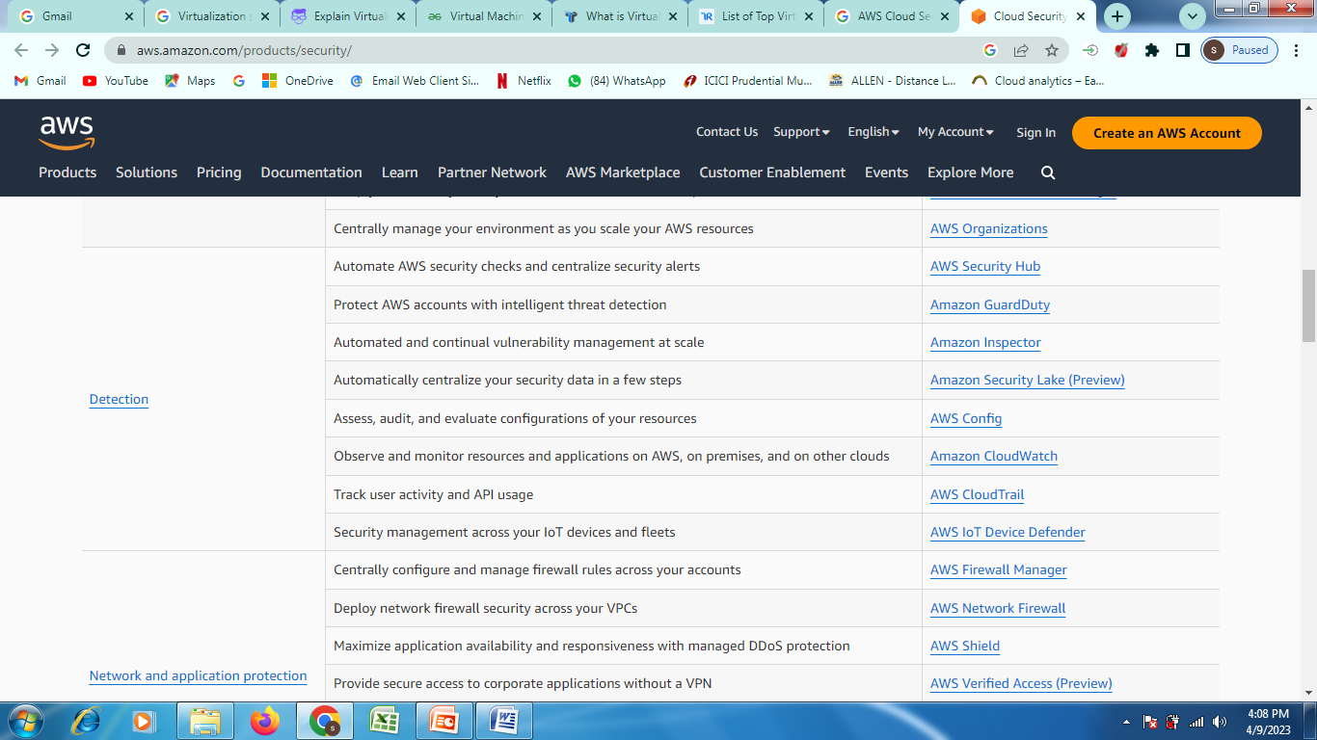
Cloud Computing Security Architecture Cont….
Software-as-a-Service (SaaS)
As part of their service contract, CSP negotiates the terms of security ownership in SaaS.
The physical, infrastructure, hypervisor, network traffic, and operating system of a business are frequently hosted through SaaS.
Following are the examples of SaaS apps:
Enforce data loss prevention (DLP)
Prevent unauthorized sharing of sensitive data to wrong people
Block sync/download of corporate data to personal devices
Detect compromised accounts, insider threats, and malware
Gain visibility into unsanctioned applications
Audit for misconfiguration
Notes:
Tools for Functional Testing in Cloud
There are many tools used for testing performance, load, stress testing in or of cloud. Some of these testing tools are mentioned below:
AppPerfect: AppPerfect is a software development company located in Sunnyvale, CA. It markets supports and develops a set of testing and monitoring products that are used to analyze, test, and monitor web and windows-based applications.
Jmeter: Apache JMeter is an open-source, Java-based application software designed to load testing tools to analyze and monitor the performance of the services and web applications.
SOASTA CloudTest: SOASTA cloud test is a cross-platform test management tool with a user-friendly design.
LoadStorm: It is a tool to manage and monitor the performance of the entire cloud infrastructure and produces a real-time graph for performance analysis.
Tools for Security Testing in Cloud
The following are the tools for security testing in the cloud:
Nessus: Nessus is a remote security scanning tool that scans the system and raises an alert if any vulnerability is discovered that hackers could use to get unauthorized access to sensitive data.
Wireshark: Wireshark is an open-source packet analyzer used for network troubleshooting and monitoring, software, and communications protocols development.
Nmap: Nmap is a network scanner that is used to discover hosts and services on a network by sending packets and analyzing the response.
Benefits Of Cloud Testing
The following are some of the benefits of cloud testing:
Availability of Required testing environment: In cloud testing, testing teams can easily replicate the customer’s environment for effective testing of the cloud without investing in the additional hardware and software resources for testing. These resources can be accessed from any device with a network connection.
Less expensive: Cloud testing is more cost-efficient than traditional methods of testing, as there is no need of investing in additional hardware and software resources. Customers, as well as the testing team, only pay for what they use.
Faster testing: Cloud testing is faster than the traditional method of testing as most of the management tasks like physical infrastructure management for testing are removed.
Scalability: The cloud computing resources can be increased and decreased whenever required, based on testing demands.
Customization: Cloud testing can be customized as per the usage, cost and time based on the variety of users and user’s environment.
Disaster recovery: Disaster recovery is easily possible as the data backup is taken at the cloud vendors as well as at the user’s end also.

Slide 62
Cloud Computing Security Architecture Cont….
Intel Cloud Security Architecture Products and Solutions
Intel® Software Guard Extensions (Intel® SGX) helps create a trusted environment by integrating security capabilities for data while being processed in memory. Developers can use Intel® SGX to establish memory enclaves that provide extra layers of workload isolation.
Cryptographic accelerators such as Intel® QuickAssist Technology (Intel® QAT) help deliver high performance even when heavy encryption and compression loads are needed.
The latest addition to the Intel® Xeon® Scalable platform also adds Intel® Total Memory Encryption (Intel® TME) and Intel® Platform Firmware Resilience (Intel® PFR). Intel® TME helps ensure that all memory accessed from the Intel® CPU is encrypted, including customer credentials, encryption keys, and other personally identifiable information.
Intel® PFR equips cloud architects with the tools to increase protection against firmware interception, detect firmware corruption, and restore systems to a known good state.
Lastly, Intel collaborates with ecosystem partners to abstract and expand trusted execution capabilities and further the paradigm of confidential computing. This helps proliferate key technologies across a vast field of developers, system vendors, and system integrators. For example, Microsoft Azure uses Intel® SGX in building their cloud security architecture, and this benefits Microsoft Azure users even if they’re not aware of it.
Notes:
Tools for Functional Testing in Cloud
There are many tools used for testing performance, load, stress testing in or of cloud. Some of these testing tools are mentioned below:
AppPerfect: AppPerfect is a software development company located in Sunnyvale, CA. It markets supports and develops a set of testing and monitoring products that are used to analyze, test, and monitor web and windows-based applications.
Jmeter: Apache JMeter is an open-source, Java-based application software designed to load testing tools to analyze and monitor the performance of the services and web applications.
SOASTA CloudTest: SOASTA cloud test is a cross-platform test management tool with a user-friendly design.
LoadStorm: It is a tool to manage and monitor the performance of the entire cloud infrastructure and produces a real-time graph for performance analysis.
Tools for Security Testing in Cloud
The following are the tools for security testing in the cloud:
Nessus: Nessus is a remote security scanning tool that scans the system and raises an alert if any vulnerability is discovered that hackers could use to get unauthorized access to sensitive data.
Wireshark: Wireshark is an open-source packet analyzer used for network troubleshooting and monitoring, software, and communications protocols development.
Nmap: Nmap is a network scanner that is used to discover hosts and services on a network by sending packets and analyzing the response.
Benefits Of Cloud Testing
The following are some of the benefits of cloud testing:
Availability of Required testing environment: In cloud testing, testing teams can easily replicate the customer’s environment for effective testing of the cloud without investing in the additional hardware and software resources for testing. These resources can be accessed from any device with a network connection.
Less expensive: Cloud testing is more cost-efficient than traditional methods of testing, as there is no need of investing in additional hardware and software resources. Customers, as well as the testing team, only pay for what they use.
Faster testing: Cloud testing is faster than the traditional method of testing as most of the management tasks like physical infrastructure management for testing are removed.
Scalability: The cloud computing resources can be increased and decreased whenever required, based on testing demands.
Customization: Cloud testing can be customized as per the usage, cost and time based on the variety of users and user’s environment.
Disaster recovery: Disaster recovery is easily possible as the data backup is taken at the cloud vendors as well as at the user’s end also.

Slide 63
Cloud Computing Security Architecture Cont….
Principles of Cloud Security Architecture
A well-designed cloud security architecture should be based on the following key principles:
Identification—Knowledge of the users, assets, business environment, policies, vulnerabilities and threats, and risk management strategies (business and supply chain) that exist within your cloud environment.
Security Controls—Defines parameters and policies implemented across users, data, and infrastructure to help manage the overall security posture.
Security by Design—Defines the control responsibilities, security configurations, and security baseline automations. Usually standardized and repeatable for deployment across common use cases, with security standards, and in audit requirements.
Compliance—Integrates industry standards and regulatory components into the architecture and ensures standards and regulatory responsibilities are met.
Perimeter Security—Protects and secures traffic in and out of organization’s cloud-based resources, including connection points between corporate network and public internet.
Segmentation—Partitions the architecture into isolated component sections to prevent lateral movement in the case of a breach. Often includes principles of ‘least privilege’.
Notes:
Tools for Functional Testing in Cloud
There are many tools used for testing performance, load, stress testing in or of cloud. Some of these testing tools are mentioned below:
AppPerfect: AppPerfect is a software development company located in Sunnyvale, CA. It markets supports and develops a set of testing and monitoring products that are used to analyze, test, and monitor web and windows-based applications.
Jmeter: Apache JMeter is an open-source, Java-based application software designed to load testing tools to analyze and monitor the performance of the services and web applications.
SOASTA CloudTest: SOASTA cloud test is a cross-platform test management tool with a user-friendly design.
LoadStorm: It is a tool to manage and monitor the performance of the entire cloud infrastructure and produces a real-time graph for performance analysis.
Tools for Security Testing in Cloud
The following are the tools for security testing in the cloud:
Nessus: Nessus is a remote security scanning tool that scans the system and raises an alert if any vulnerability is discovered that hackers could use to get unauthorized access to sensitive data.
Wireshark: Wireshark is an open-source packet analyzer used for network troubleshooting and monitoring, software, and communications protocols development.
Nmap: Nmap is a network scanner that is used to discover hosts and services on a network by sending packets and analyzing the response.
Benefits Of Cloud Testing
The following are some of the benefits of cloud testing:
Availability of Required testing environment: In cloud testing, testing teams can easily replicate the customer’s environment for effective testing of the cloud without investing in the additional hardware and software resources for testing. These resources can be accessed from any device with a network connection.
Less expensive: Cloud testing is more cost-efficient than traditional methods of testing, as there is no need of investing in additional hardware and software resources. Customers, as well as the testing team, only pay for what they use.
Faster testing: Cloud testing is faster than the traditional method of testing as most of the management tasks like physical infrastructure management for testing are removed.
Scalability: The cloud computing resources can be increased and decreased whenever required, based on testing demands.
Customization: Cloud testing can be customized as per the usage, cost and time based on the variety of users and user’s environment.
Disaster recovery: Disaster recovery is easily possible as the data backup is taken at the cloud vendors as well as at the user’s end also.

Slide 64
Cloud Computing Security Architecture Cont….
Principles of Cloud Security Architecture Cont…..
User Identity and Access Management—Ensures understanding, visibility, and control into all users (people, devices, and systems) that access corporate assets. Enables enforcement of access, permissions, and protocols.
Data encryption—Ensures data at rest and traveling between internal and external cloud connection points is encrypted to minimize breach impact.
Automation—Facilitates rapid security and configuration provisioning and updates as well as quick threat detection.
Logging and Monitoring—Captures activities and constant observation (often automated) of all activity on connected systems and cloud-based services to ensure compliance, visibility into operations, and awareness of threats.
Visibility—Incorporates tools and processes to maintain visibility across an organization’s multiple cloud deployments.
Flexible Design—Ensuring architecture design is sufficiently agile to develop and incorporate new components and solutions without sacrificing inherent security.
Notes:
Tools for Functional Testing in Cloud
There are many tools used for testing performance, load, stress testing in or of cloud. Some of these testing tools are mentioned below:
AppPerfect: AppPerfect is a software development company located in Sunnyvale, CA. It markets supports and develops a set of testing and monitoring products that are used to analyze, test, and monitor web and windows-based applications.
Jmeter: Apache JMeter is an open-source, Java-based application software designed to load testing tools to analyze and monitor the performance of the services and web applications.
SOASTA CloudTest: SOASTA cloud test is a cross-platform test management tool with a user-friendly design.
LoadStorm: It is a tool to manage and monitor the performance of the entire cloud infrastructure and produces a real-time graph for performance analysis.
Tools for Security Testing in Cloud
The following are the tools for security testing in the cloud:
Nessus: Nessus is a remote security scanning tool that scans the system and raises an alert if any vulnerability is discovered that hackers could use to get unauthorized access to sensitive data.
Wireshark: Wireshark is an open-source packet analyzer used for network troubleshooting and monitoring, software, and communications protocols development.
Nmap: Nmap is a network scanner that is used to discover hosts and services on a network by sending packets and analyzing the response.
Benefits Of Cloud Testing
The following are some of the benefits of cloud testing:
Availability of Required testing environment: In cloud testing, testing teams can easily replicate the customer’s environment for effective testing of the cloud without investing in the additional hardware and software resources for testing. These resources can be accessed from any device with a network connection.
Less expensive: Cloud testing is more cost-efficient than traditional methods of testing, as there is no need of investing in additional hardware and software resources. Customers, as well as the testing team, only pay for what they use.
Faster testing: Cloud testing is faster than the traditional method of testing as most of the management tasks like physical infrastructure management for testing are removed.
Scalability: The cloud computing resources can be increased and decreased whenever required, based on testing demands.
Customization: Cloud testing can be customized as per the usage, cost and time based on the variety of users and user’s environment.
Disaster recovery: Disaster recovery is easily possible as the data backup is taken at the cloud vendors as well as at the user’s end also.

Slide 65
Cloud Security challenges
Lack of visibility: It's easy to lose track of how your data is being accessed and by whom, since many cloud services are accessed outside of corporate networks and through third parties.
Multi-tenancy: Public cloud environments house multiple client infrastructures under the same umbrella, so it's possible your hosted services can get compromised by malicious attackers as collateral damage when targeting other businesses.
Access management and shadow IT: While enterprises may be able to successfully manage and restrict access points across on-premises systems, administering these same levels of restrictions can be challenging in cloud environments. This can be dangerous for organizations that don't deploy bring-your-own device (BYOD) policies and allow unfiltered access to cloud services from any device or geolocation.
Compliance: Overall accountability for data privacy and security still rests with the enterprise, and heavy reliance on third-party solutions to manage this component can lead to costly compliance issues.
Misconfigurations: Misconfigured assets accounted for 86% of breached records in 2019, making the inadvertent insider a key issue for cloud computing environments. Misconfigurations can include leaving default administrative passwords in place, or not creating appropriate privacy settings.
Notes:
Tools for Functional Testing in Cloud
There are many tools used for testing performance, load, stress testing in or of cloud. Some of these testing tools are mentioned below:
AppPerfect: AppPerfect is a software development company located in Sunnyvale, CA. It markets supports and develops a set of testing and monitoring products that are used to analyze, test, and monitor web and windows-based applications.
Jmeter: Apache JMeter is an open-source, Java-based application software designed to load testing tools to analyze and monitor the performance of the services and web applications.
SOASTA CloudTest: SOASTA cloud test is a cross-platform test management tool with a user-friendly design.
LoadStorm: It is a tool to manage and monitor the performance of the entire cloud infrastructure and produces a real-time graph for performance analysis.
Tools for Security Testing in Cloud
The following are the tools for security testing in the cloud:
Nessus: Nessus is a remote security scanning tool that scans the system and raises an alert if any vulnerability is discovered that hackers could use to get unauthorized access to sensitive data.
Wireshark: Wireshark is an open-source packet analyzer used for network troubleshooting and monitoring, software, and communications protocols development.
Nmap: Nmap is a network scanner that is used to discover hosts and services on a network by sending packets and analyzing the response.
Benefits Of Cloud Testing
The following are some of the benefits of cloud testing:
Availability of Required testing environment: In cloud testing, testing teams can easily replicate the customer’s environment for effective testing of the cloud without investing in the additional hardware and software resources for testing. These resources can be accessed from any device with a network connection.
Less expensive: Cloud testing is more cost-efficient than traditional methods of testing, as there is no need of investing in additional hardware and software resources. Customers, as well as the testing team, only pay for what they use.
Faster testing: Cloud testing is faster than the traditional method of testing as most of the management tasks like physical infrastructure management for testing are removed.
Scalability: The cloud computing resources can be increased and decreased whenever required, based on testing demands.
Customization: Cloud testing can be customized as per the usage, cost and time based on the variety of users and user’s environment.
Disaster recovery: Disaster recovery is easily possible as the data backup is taken at the cloud vendors as well as at the user’s end also.

Slide 66
Cloud Security Policy Implementation
Cloud policies are the guidelines under which companies operate in the cloud.
These guidelines define the security strategy and guide all decisions concerning the safety of cloud assets. Cloud security policies specify:
Data types that can and cannot move to the cloud
How teams address the risks for each data type
Who makes decisions about shifting workloads to the cloud
Who is authorized to access or migrate the data
Regulation terms and current compliance status
Proper responses to threats, hacking attempts, and data breaches
Rules surrounding risk prioritization
Notes:
Tools for Functional Testing in Cloud
There are many tools used for testing performance, load, stress testing in or of cloud. Some of these testing tools are mentioned below:
AppPerfect: AppPerfect is a software development company located in Sunnyvale, CA. It markets supports and develops a set of testing and monitoring products that are used to analyze, test, and monitor web and windows-based applications.
Jmeter: Apache JMeter is an open-source, Java-based application software designed to load testing tools to analyze and monitor the performance of the services and web applications.
SOASTA CloudTest: SOASTA cloud test is a cross-platform test management tool with a user-friendly design.
LoadStorm: It is a tool to manage and monitor the performance of the entire cloud infrastructure and produces a real-time graph for performance analysis.
Tools for Security Testing in Cloud
The following are the tools for security testing in the cloud:
Nessus: Nessus is a remote security scanning tool that scans the system and raises an alert if any vulnerability is discovered that hackers could use to get unauthorized access to sensitive data.
Wireshark: Wireshark is an open-source packet analyzer used for network troubleshooting and monitoring, software, and communications protocols development.
Nmap: Nmap is a network scanner that is used to discover hosts and services on a network by sending packets and analyzing the response.
Benefits Of Cloud Testing
The following are some of the benefits of cloud testing:
Availability of Required testing environment: In cloud testing, testing teams can easily replicate the customer’s environment for effective testing of the cloud without investing in the additional hardware and software resources for testing. These resources can be accessed from any device with a network connection.
Less expensive: Cloud testing is more cost-efficient than traditional methods of testing, as there is no need of investing in additional hardware and software resources. Customers, as well as the testing team, only pay for what they use.
Faster testing: Cloud testing is faster than the traditional method of testing as most of the management tasks like physical infrastructure management for testing are removed.
Scalability: The cloud computing resources can be increased and decreased whenever required, based on testing demands.
Customization: Cloud testing can be customized as per the usage, cost and time based on the variety of users and user’s environment.
Disaster recovery: Disaster recovery is easily possible as the data backup is taken at the cloud vendors as well as at the user’s end also.

Slide 67
Cloud Security Policy Implementation Cont…..
Often implemented in order to ensure the integrity and privacy of company-owned information.
Without the implementation and enforcement of cloud policies, companies can be exposed to the risks of data loss, spiraling costs, and underperforming assets.
Cloud policies can also be used for financial management, cost optimization, performance management, and network security.
Cloud service providers build their platforms focusing more on security and governance than companies who build on-premises IT infrastructures that are protected by a firewall.
Company’s should take advantage of cloud service providers´ tools: to encrypt data and control who has access to it, and to implement cloud policies that address the issue of inappropriately-protected deployments.
To ensure these policies are enforced, companies can use cloud management platforms that collect and analyze logs and create audit trails in order to identify and correct policy violations.
Notes:
Tools for Functional Testing in Cloud
There are many tools used for testing performance, load, stress testing in or of cloud. Some of these testing tools are mentioned below:
AppPerfect: AppPerfect is a software development company located in Sunnyvale, CA. It markets supports and develops a set of testing and monitoring products that are used to analyze, test, and monitor web and windows-based applications.
Jmeter: Apache JMeter is an open-source, Java-based application software designed to load testing tools to analyze and monitor the performance of the services and web applications.
SOASTA CloudTest: SOASTA cloud test is a cross-platform test management tool with a user-friendly design.
LoadStorm: It is a tool to manage and monitor the performance of the entire cloud infrastructure and produces a real-time graph for performance analysis.
Tools for Security Testing in Cloud
The following are the tools for security testing in the cloud:
Nessus: Nessus is a remote security scanning tool that scans the system and raises an alert if any vulnerability is discovered that hackers could use to get unauthorized access to sensitive data.
Wireshark: Wireshark is an open-source packet analyzer used for network troubleshooting and monitoring, software, and communications protocols development.
Nmap: Nmap is a network scanner that is used to discover hosts and services on a network by sending packets and analyzing the response.
Benefits Of Cloud Testing
The following are some of the benefits of cloud testing:
Availability of Required testing environment: In cloud testing, testing teams can easily replicate the customer’s environment for effective testing of the cloud without investing in the additional hardware and software resources for testing. These resources can be accessed from any device with a network connection.
Less expensive: Cloud testing is more cost-efficient than traditional methods of testing, as there is no need of investing in additional hardware and software resources. Customers, as well as the testing team, only pay for what they use.
Faster testing: Cloud testing is faster than the traditional method of testing as most of the management tasks like physical infrastructure management for testing are removed.
Scalability: The cloud computing resources can be increased and decreased whenever required, based on testing demands.
Customization: Cloud testing can be customized as per the usage, cost and time based on the variety of users and user’s environment.
Disaster recovery: Disaster recovery is easily possible as the data backup is taken at the cloud vendors as well as at the user’s end also.

Slide 68
Cloud Security Policy Implementation Cont….
Cloud policies can also be used for financial management, cost optimization, performance management, and network security.
Cloud policies for financial management not only help control operational budgets and monitor cost trends, but can be useful in identifying sudden increases in cloud spend that could be indicators of a bigger security problem—for example hackers obtaining login credentials and launching Virtual Machines on the company’s cloud account that are then used for cryptocurrency mining.
Cloud policies for financial management can identify unexpected increases in costs due to unauthorized CPU or bandwidth usage.
Additionally, establishing a Cloud Financial Management practice can also help cost optimization process. Cloud Financial Management (CFM), also known as FinOps or Cloud Cost Management, is a function that helps align and develop financial goals, drive a cost-conscious culture, establish guardrails to meet financial targets, and gain greater business efficiencies.
Notes:
Tools for Functional Testing in Cloud
There are many tools used for testing performance, load, stress testing in or of cloud. Some of these testing tools are mentioned below:
AppPerfect: AppPerfect is a software development company located in Sunnyvale, CA. It markets supports and develops a set of testing and monitoring products that are used to analyze, test, and monitor web and windows-based applications.
Jmeter: Apache JMeter is an open-source, Java-based application software designed to load testing tools to analyze and monitor the performance of the services and web applications.
SOASTA CloudTest: SOASTA cloud test is a cross-platform test management tool with a user-friendly design.
LoadStorm: It is a tool to manage and monitor the performance of the entire cloud infrastructure and produces a real-time graph for performance analysis.
Tools for Security Testing in Cloud
The following are the tools for security testing in the cloud:
Nessus: Nessus is a remote security scanning tool that scans the system and raises an alert if any vulnerability is discovered that hackers could use to get unauthorized access to sensitive data.
Wireshark: Wireshark is an open-source packet analyzer used for network troubleshooting and monitoring, software, and communications protocols development.
Nmap: Nmap is a network scanner that is used to discover hosts and services on a network by sending packets and analyzing the response.
Benefits Of Cloud Testing
The following are some of the benefits of cloud testing:
Availability of Required testing environment: In cloud testing, testing teams can easily replicate the customer’s environment for effective testing of the cloud without investing in the additional hardware and software resources for testing. These resources can be accessed from any device with a network connection.
Less expensive: Cloud testing is more cost-efficient than traditional methods of testing, as there is no need of investing in additional hardware and software resources. Customers, as well as the testing team, only pay for what they use.
Faster testing: Cloud testing is faster than the traditional method of testing as most of the management tasks like physical infrastructure management for testing are removed.
Scalability: The cloud computing resources can be increased and decreased whenever required, based on testing demands.
Customization: Cloud testing can be customized as per the usage, cost and time based on the variety of users and user’s environment.
Disaster recovery: Disaster recovery is easily possible as the data backup is taken at the cloud vendors as well as at the user’s end also.

Slide 69
Cloud Security Policy Implementation Cont….
Cost optimization cloud policies
Software solutions for optimizing cloud costs are available from cloud service providers or—if your business operates in a multi-cloud or hybrid cloud environment—third party software solutions are available from multiple vendors.
These solutions often have the capability to apply cost optimization cloud policies to assets across multiple platforms.
Cloud policies for performance management
Cloud policies for performance management enable you to specify performance thresholds for Virtual Machines and storage volumes so you can monitor for underutilized and overutilized assets.
Underutilized Virtual Machines and storage volumes should be downgraded for cost efficiency, while overutilized assets should be upgraded to avoid performance headaches.
It is important to remember the application of cloud policies for performance management will affect the policies put in place for financial management and cost optimization. For example, if you upgrade assets to increase their performance, this will have an impact on operational budgets and cost optimization. If you downgrade assets, the reverse will apply.
Notes:
Tools for Functional Testing in Cloud
There are many tools used for testing performance, load, stress testing in or of cloud. Some of these testing tools are mentioned below:
AppPerfect: AppPerfect is a software development company located in Sunnyvale, CA. It markets supports and develops a set of testing and monitoring products that are used to analyze, test, and monitor web and windows-based applications.
Jmeter: Apache JMeter is an open-source, Java-based application software designed to load testing tools to analyze and monitor the performance of the services and web applications.
SOASTA CloudTest: SOASTA cloud test is a cross-platform test management tool with a user-friendly design.
LoadStorm: It is a tool to manage and monitor the performance of the entire cloud infrastructure and produces a real-time graph for performance analysis.
Tools for Security Testing in Cloud
The following are the tools for security testing in the cloud:
Nessus: Nessus is a remote security scanning tool that scans the system and raises an alert if any vulnerability is discovered that hackers could use to get unauthorized access to sensitive data.
Wireshark: Wireshark is an open-source packet analyzer used for network troubleshooting and monitoring, software, and communications protocols development.
Nmap: Nmap is a network scanner that is used to discover hosts and services on a network by sending packets and analyzing the response.
Benefits Of Cloud Testing
The following are some of the benefits of cloud testing:
Availability of Required testing environment: In cloud testing, testing teams can easily replicate the customer’s environment for effective testing of the cloud without investing in the additional hardware and software resources for testing. These resources can be accessed from any device with a network connection.
Less expensive: Cloud testing is more cost-efficient than traditional methods of testing, as there is no need of investing in additional hardware and software resources. Customers, as well as the testing team, only pay for what they use.
Faster testing: Cloud testing is faster than the traditional method of testing as most of the management tasks like physical infrastructure management for testing are removed.
Scalability: The cloud computing resources can be increased and decreased whenever required, based on testing demands.
Customization: Cloud testing can be customized as per the usage, cost and time based on the variety of users and user’s environment.
Disaster recovery: Disaster recovery is easily possible as the data backup is taken at the cloud vendors as well as at the user’s end also.

Slide 70
Cloud Security Policy Implementation Cont….
Network security cloud policies
Maintaining a secure perimeter to allow only legitimate traffic onto your network is critical in the cloud
The leading cloud service providers supply tools to determine which users or group identities should have access to hosted services and applications.
Amazon and Microsoft both call their tools “Security Groups”, Google offers the “Identity-Aware Service”.
Within each of these tools, the capability exists to apply network security cloud policies that define what inbound traffic is allowed.
If using cloud policies for access control, best practice is to apply policies to alert you to Security Group misconfigurations, when new Security Groups are created, when Security Groups exist that are not being used, and when assets have too many rules applied to them.
Notes:
Tools for Functional Testing in Cloud
There are many tools used for testing performance, load, stress testing in or of cloud. Some of these testing tools are mentioned below:
AppPerfect: AppPerfect is a software development company located in Sunnyvale, CA. It markets supports and develops a set of testing and monitoring products that are used to analyze, test, and monitor web and windows-based applications.
Jmeter: Apache JMeter is an open-source, Java-based application software designed to load testing tools to analyze and monitor the performance of the services and web applications.
SOASTA CloudTest: SOASTA cloud test is a cross-platform test management tool with a user-friendly design.
LoadStorm: It is a tool to manage and monitor the performance of the entire cloud infrastructure and produces a real-time graph for performance analysis.
Tools for Security Testing in Cloud
The following are the tools for security testing in the cloud:
Nessus: Nessus is a remote security scanning tool that scans the system and raises an alert if any vulnerability is discovered that hackers could use to get unauthorized access to sensitive data.
Wireshark: Wireshark is an open-source packet analyzer used for network troubleshooting and monitoring, software, and communications protocols development.
Nmap: Nmap is a network scanner that is used to discover hosts and services on a network by sending packets and analyzing the response.
Benefits Of Cloud Testing
The following are some of the benefits of cloud testing:
Availability of Required testing environment: In cloud testing, testing teams can easily replicate the customer’s environment for effective testing of the cloud without investing in the additional hardware and software resources for testing. These resources can be accessed from any device with a network connection.
Less expensive: Cloud testing is more cost-efficient than traditional methods of testing, as there is no need of investing in additional hardware and software resources. Customers, as well as the testing team, only pay for what they use.
Faster testing: Cloud testing is faster than the traditional method of testing as most of the management tasks like physical infrastructure management for testing are removed.
Scalability: The cloud computing resources can be increased and decreased whenever required, based on testing demands.
Customization: Cloud testing can be customized as per the usage, cost and time based on the variety of users and user’s environment.
Disaster recovery: Disaster recovery is easily possible as the data backup is taken at the cloud vendors as well as at the user’s end also.

Slide 71
Cloud Security Policy Implementation Cont….
Automating the enforcement of cloud policies
Prior to creating cloud policies, it is essential to have total visibility over your cloud environment in order to fully understand what assets your company has deployed in the cloud and how they are being used.
CloudHealth gives you the total visibility required and tools to analyze costs, usage, performance, and security to enable you to make informed choices when applying cloud policies.
CloudHealth then automates governance of your cloud policies to provide continuous monitoring – alerting you to events that require your attention or that may require you to revisit your policies as your presence in the cloud evolves and grows.
Notes:
Tools for Functional Testing in Cloud
There are many tools used for testing performance, load, stress testing in or of cloud. Some of these testing tools are mentioned below:
AppPerfect: AppPerfect is a software development company located in Sunnyvale, CA. It markets supports and develops a set of testing and monitoring products that are used to analyze, test, and monitor web and windows-based applications.
Jmeter: Apache JMeter is an open-source, Java-based application software designed to load testing tools to analyze and monitor the performance of the services and web applications.
SOASTA CloudTest: SOASTA cloud test is a cross-platform test management tool with a user-friendly design.
LoadStorm: It is a tool to manage and monitor the performance of the entire cloud infrastructure and produces a real-time graph for performance analysis.
Tools for Security Testing in Cloud
The following are the tools for security testing in the cloud:
Nessus: Nessus is a remote security scanning tool that scans the system and raises an alert if any vulnerability is discovered that hackers could use to get unauthorized access to sensitive data.
Wireshark: Wireshark is an open-source packet analyzer used for network troubleshooting and monitoring, software, and communications protocols development.
Nmap: Nmap is a network scanner that is used to discover hosts and services on a network by sending packets and analyzing the response.
Benefits Of Cloud Testing
The following are some of the benefits of cloud testing:
Availability of Required testing environment: In cloud testing, testing teams can easily replicate the customer’s environment for effective testing of the cloud without investing in the additional hardware and software resources for testing. These resources can be accessed from any device with a network connection.
Less expensive: Cloud testing is more cost-efficient than traditional methods of testing, as there is no need of investing in additional hardware and software resources. Customers, as well as the testing team, only pay for what they use.
Faster testing: Cloud testing is faster than the traditional method of testing as most of the management tasks like physical infrastructure management for testing are removed.
Scalability: The cloud computing resources can be increased and decreased whenever required, based on testing demands.
Customization: Cloud testing can be customized as per the usage, cost and time based on the variety of users and user’s environment.
Disaster recovery: Disaster recovery is easily possible as the data backup is taken at the cloud vendors as well as at the user’s end also.

Slide 72
Cloud Security Policy Implementation Cont…
Writing effective security policies is a three-step process: defining the policy, implementing the policy, and managing the policy. The following information explains these steps in more detail.
Defining the policy: Gather the information you need to define an effective security policy.
Implementing the policy: After you have defined your needs for a security policy, you can use IBM Secure Perspective to implement that policy
Managing the policy: Use Secure Perspective [IBM Secure Perspective is a tool you can use to meet your security needs] to continue to manage the security policy you have defined and implemented for your business.
After you have defined your needs for a security policy, you can use IBM Secure Perspective to implement that policy.
To implement a security policy, do the complete the following actions:
Enter the data types that you identified into Secure Perspective as Resources.
Enter the roles that you identified into Secure Perspective as Actors.
Enter the data interactions that you identified into Secure Perspective as Actions.
Notes:
Tools for Functional Testing in Cloud
There are many tools used for testing performance, load, stress testing in or of cloud. Some of these testing tools are mentioned below:
AppPerfect: AppPerfect is a software development company located in Sunnyvale, CA. It markets supports and develops a set of testing and monitoring products that are used to analyze, test, and monitor web and windows-based applications.
Jmeter: Apache JMeter is an open-source, Java-based application software designed to load testing tools to analyze and monitor the performance of the services and web applications.
SOASTA CloudTest: SOASTA cloud test is a cross-platform test management tool with a user-friendly design.
LoadStorm: It is a tool to manage and monitor the performance of the entire cloud infrastructure and produces a real-time graph for performance analysis.
Tools for Security Testing in Cloud
The following are the tools for security testing in the cloud:
Nessus: Nessus is a remote security scanning tool that scans the system and raises an alert if any vulnerability is discovered that hackers could use to get unauthorized access to sensitive data.
Wireshark: Wireshark is an open-source packet analyzer used for network troubleshooting and monitoring, software, and communications protocols development.
Nmap: Nmap is a network scanner that is used to discover hosts and services on a network by sending packets and analyzing the response.
Benefits Of Cloud Testing
The following are some of the benefits of cloud testing:
Availability of Required testing environment: In cloud testing, testing teams can easily replicate the customer’s environment for effective testing of the cloud without investing in the additional hardware and software resources for testing. These resources can be accessed from any device with a network connection.
Less expensive: Cloud testing is more cost-efficient than traditional methods of testing, as there is no need of investing in additional hardware and software resources. Customers, as well as the testing team, only pay for what they use.
Faster testing: Cloud testing is faster than the traditional method of testing as most of the management tasks like physical infrastructure management for testing are removed.
Scalability: The cloud computing resources can be increased and decreased whenever required, based on testing demands.
Customization: Cloud testing can be customized as per the usage, cost and time based on the variety of users and user’s environment.
Disaster recovery: Disaster recovery is easily possible as the data backup is taken at the cloud vendors as well as at the user’s end also.

Slide 73
Cloud Security Policy Implementation Cont…
Implementing the policy
You can use the following steps as guidelines for using Secure Perspective to write and apply a security policy.
Create clear and meaningful policy statements.
Identify the systems that contain relevant data that need to be connected to the controlling system. On Secure Perspective, add these machines to the system configuration list.
Connect policy terms to digital assets. Be aware of the file system’s hierarchy and how this affects users’ access to files within directories. In Secure Perspective, map resources to data assets, actors to user profiles, and actions to system actions.
Check current compliance. You may need to make adjustments on your system if it fails to comply with your policy. After applying patches or fixes, you might want to run a compliance check.
Use problem prediction to determine whether your current processes could be affected by the application of your security policy. You may need to modify your policy if it interferes with essential system procedures.
Use Secure Perspective to apply the policy. You can read the report for details and investigate any questionable failures. Can Undo the policy and make adjustments as necessary.
Notes:
Tools for Functional Testing in Cloud
There are many tools used for testing performance, load, stress testing in or of cloud. Some of these testing tools are mentioned below:
AppPerfect: AppPerfect is a software development company located in Sunnyvale, CA. It markets supports and develops a set of testing and monitoring products that are used to analyze, test, and monitor web and windows-based applications.
Jmeter: Apache JMeter is an open-source, Java-based application software designed to load testing tools to analyze and monitor the performance of the services and web applications.
SOASTA CloudTest: SOASTA cloud test is a cross-platform test management tool with a user-friendly design.
LoadStorm: It is a tool to manage and monitor the performance of the entire cloud infrastructure and produces a real-time graph for performance analysis.
Tools for Security Testing in Cloud
The following are the tools for security testing in the cloud:
Nessus: Nessus is a remote security scanning tool that scans the system and raises an alert if any vulnerability is discovered that hackers could use to get unauthorized access to sensitive data.
Wireshark: Wireshark is an open-source packet analyzer used for network troubleshooting and monitoring, software, and communications protocols development.
Nmap: Nmap is a network scanner that is used to discover hosts and services on a network by sending packets and analyzing the response.
Benefits Of Cloud Testing
The following are some of the benefits of cloud testing:
Availability of Required testing environment: In cloud testing, testing teams can easily replicate the customer’s environment for effective testing of the cloud without investing in the additional hardware and software resources for testing. These resources can be accessed from any device with a network connection.
Less expensive: Cloud testing is more cost-efficient than traditional methods of testing, as there is no need of investing in additional hardware and software resources. Customers, as well as the testing team, only pay for what they use.
Faster testing: Cloud testing is faster than the traditional method of testing as most of the management tasks like physical infrastructure management for testing are removed.
Scalability: The cloud computing resources can be increased and decreased whenever required, based on testing demands.
Customization: Cloud testing can be customized as per the usage, cost and time based on the variety of users and user’s environment.
Disaster recovery: Disaster recovery is easily possible as the data backup is taken at the cloud vendors as well as at the user’s end also.

Slide 74
Cloud Security Policy Implementation Cont…
NOTE: Restriction: Secure Perspective uses authorization lists to secure objects. The maximum number of files and members that can be secured by a single resource term is 2 097 104. If you apply a policy when more than 2 097 104 items (files added to the sum of the members in those files) are mapped to a term, the application of the policy to will fail. An error message is shown on the display screen.
Notes:
Tools for Functional Testing in Cloud
There are many tools used for testing performance, load, stress testing in or of cloud. Some of these testing tools are mentioned below:
AppPerfect: AppPerfect is a software development company located in Sunnyvale, CA. It markets supports and develops a set of testing and monitoring products that are used to analyze, test, and monitor web and windows-based applications.
Jmeter: Apache JMeter is an open-source, Java-based application software designed to load testing tools to analyze and monitor the performance of the services and web applications.
SOASTA CloudTest: SOASTA cloud test is a cross-platform test management tool with a user-friendly design.
LoadStorm: It is a tool to manage and monitor the performance of the entire cloud infrastructure and produces a real-time graph for performance analysis.
Tools for Security Testing in Cloud
The following are the tools for security testing in the cloud:
Nessus: Nessus is a remote security scanning tool that scans the system and raises an alert if any vulnerability is discovered that hackers could use to get unauthorized access to sensitive data.
Wireshark: Wireshark is an open-source packet analyzer used for network troubleshooting and monitoring, software, and communications protocols development.
Nmap: Nmap is a network scanner that is used to discover hosts and services on a network by sending packets and analyzing the response.
Benefits Of Cloud Testing
The following are some of the benefits of cloud testing:
Availability of Required testing environment: In cloud testing, testing teams can easily replicate the customer’s environment for effective testing of the cloud without investing in the additional hardware and software resources for testing. These resources can be accessed from any device with a network connection.
Less expensive: Cloud testing is more cost-efficient than traditional methods of testing, as there is no need of investing in additional hardware and software resources. Customers, as well as the testing team, only pay for what they use.
Faster testing: Cloud testing is faster than the traditional method of testing as most of the management tasks like physical infrastructure management for testing are removed.
Scalability: The cloud computing resources can be increased and decreased whenever required, based on testing demands.
Customization: Cloud testing can be customized as per the usage, cost and time based on the variety of users and user’s environment.
Disaster recovery: Disaster recovery is easily possible as the data backup is taken at the cloud vendors as well as at the user’s end also.

Slide 75
Virtualization security Management
Virtualized security, or security virtualization, refers to security solutions that are software-based and designed to work within a virtualized IT environment.
Virtualization security is the collective measures, procedures and processes that ensure the protection of a virtualization infrastructure / environment.
It addresses the security issues faced by the components of a virtualization environment and methods through which it can be mitigated or prevented.
Virtualization security is a broad concept that includes a number of different methods to evaluate, implement, monitor and manage security within a virtualization infrastructure / environment.
Notes:
Tools for Functional Testing in Cloud
There are many tools used for testing performance, load, stress testing in or of cloud. Some of these testing tools are mentioned below:
AppPerfect: AppPerfect is a software development company located in Sunnyvale, CA. It markets supports and develops a set of testing and monitoring products that are used to analyze, test, and monitor web and windows-based applications.
Jmeter: Apache JMeter is an open-source, Java-based application software designed to load testing tools to analyze and monitor the performance of the services and web applications.
SOASTA CloudTest: SOASTA cloud test is a cross-platform test management tool with a user-friendly design.
LoadStorm: It is a tool to manage and monitor the performance of the entire cloud infrastructure and produces a real-time graph for performance analysis.
Tools for Security Testing in Cloud
The following are the tools for security testing in the cloud:
Nessus: Nessus is a remote security scanning tool that scans the system and raises an alert if any vulnerability is discovered that hackers could use to get unauthorized access to sensitive data.
Wireshark: Wireshark is an open-source packet analyzer used for network troubleshooting and monitoring, software, and communications protocols development.
Nmap: Nmap is a network scanner that is used to discover hosts and services on a network by sending packets and analyzing the response.
Benefits Of Cloud Testing
The following are some of the benefits of cloud testing:
Availability of Required testing environment: In cloud testing, testing teams can easily replicate the customer’s environment for effective testing of the cloud without investing in the additional hardware and software resources for testing. These resources can be accessed from any device with a network connection.
Less expensive: Cloud testing is more cost-efficient than traditional methods of testing, as there is no need of investing in additional hardware and software resources. Customers, as well as the testing team, only pay for what they use.
Faster testing: Cloud testing is faster than the traditional method of testing as most of the management tasks like physical infrastructure management for testing are removed.
Scalability: The cloud computing resources can be increased and decreased whenever required, based on testing demands.
Customization: Cloud testing can be customized as per the usage, cost and time based on the variety of users and user’s environment.
Disaster recovery: Disaster recovery is easily possible as the data backup is taken at the cloud vendors as well as at the user’s end also.

Slide 76
Virtualization security Management Cont…..
Problems Security Virtualization Addresses
Virtualization centralizes administrative tasks while improving scalability and workloads, and leads to the consolidation of network infrastructure, lower OPEX (Operational EXpenditure), and ease of management.
However, virtualization also introduces security challenges that physical security systems cannot adequately protect against:
File sharing between hosts and guests is not secure.
Isolation between components such as guest OSs and applications, hypervisors, hardware are weakened.
For intrusion prevention systems (IPS), malware targeted for physical and virtual machines causes infection via the virtual network.
Other security threats include unauthorized access, denial of service, and exploits.
Notes:
Tools for Functional Testing in Cloud
There are many tools used for testing performance, load, stress testing in or of cloud. Some of these testing tools are mentioned below:
AppPerfect: AppPerfect is a software development company located in Sunnyvale, CA. It markets supports and develops a set of testing and monitoring products that are used to analyze, test, and monitor web and windows-based applications.
Jmeter: Apache JMeter is an open-source, Java-based application software designed to load testing tools to analyze and monitor the performance of the services and web applications.
SOASTA CloudTest: SOASTA cloud test is a cross-platform test management tool with a user-friendly design.
LoadStorm: It is a tool to manage and monitor the performance of the entire cloud infrastructure and produces a real-time graph for performance analysis.
Tools for Security Testing in Cloud
The following are the tools for security testing in the cloud:
Nessus: Nessus is a remote security scanning tool that scans the system and raises an alert if any vulnerability is discovered that hackers could use to get unauthorized access to sensitive data.
Wireshark: Wireshark is an open-source packet analyzer used for network troubleshooting and monitoring, software, and communications protocols development.
Nmap: Nmap is a network scanner that is used to discover hosts and services on a network by sending packets and analyzing the response.
Benefits Of Cloud Testing
The following are some of the benefits of cloud testing:
Availability of Required testing environment: In cloud testing, testing teams can easily replicate the customer’s environment for effective testing of the cloud without investing in the additional hardware and software resources for testing. These resources can be accessed from any device with a network connection.
Less expensive: Cloud testing is more cost-efficient than traditional methods of testing, as there is no need of investing in additional hardware and software resources. Customers, as well as the testing team, only pay for what they use.
Faster testing: Cloud testing is faster than the traditional method of testing as most of the management tasks like physical infrastructure management for testing are removed.
Scalability: The cloud computing resources can be increased and decreased whenever required, based on testing demands.
Customization: Cloud testing can be customized as per the usage, cost and time based on the variety of users and user’s environment.
Disaster recovery: Disaster recovery is easily possible as the data backup is taken at the cloud vendors as well as at the user’s end also.

Slide 77
Virtualization security Management Cont…..
Typically, virtualization security may include processes such as:
Implementation of security controls and procedures granularly at each virtual machine.
Securing virtual machines, virtual network and other virtual appliance with attacks and vulnerabilities surfaced from the underlying physical device.
Ensuring control and authority over each virtual machine.
Creation and implementation of security policy across the infrastructure / environment
How Does Security Virtualization Work?
A virtualization system consists of a host operating system, a hypervisor, and a guest operating system. Juniper Networks Implementation
The vSRX Services Gateway is a stateful firewall that integrates with a hypervisor at the kernel and inspects and secures traffic at the virtual layer. The vSRX allows administrators to provision and scale firewall protection to meet the needs of virtualized and cloud environments.
Notes:
Tools for Functional Testing in Cloud
There are many tools used for testing performance, load, stress testing in or of cloud. Some of these testing tools are mentioned below:
AppPerfect: AppPerfect is a software development company located in Sunnyvale, CA. It markets supports and develops a set of testing and monitoring products that are used to analyze, test, and monitor web and windows-based applications.
Jmeter: Apache JMeter is an open-source, Java-based application software designed to load testing tools to analyze and monitor the performance of the services and web applications.
SOASTA CloudTest: SOASTA cloud test is a cross-platform test management tool with a user-friendly design.
LoadStorm: It is a tool to manage and monitor the performance of the entire cloud infrastructure and produces a real-time graph for performance analysis.
Tools for Security Testing in Cloud
The following are the tools for security testing in the cloud:
Nessus: Nessus is a remote security scanning tool that scans the system and raises an alert if any vulnerability is discovered that hackers could use to get unauthorized access to sensitive data.
Wireshark: Wireshark is an open-source packet analyzer used for network troubleshooting and monitoring, software, and communications protocols development.
Nmap: Nmap is a network scanner that is used to discover hosts and services on a network by sending packets and analyzing the response.
Benefits Of Cloud Testing
The following are some of the benefits of cloud testing:
Availability of Required testing environment: In cloud testing, testing teams can easily replicate the customer’s environment for effective testing of the cloud without investing in the additional hardware and software resources for testing. These resources can be accessed from any device with a network connection.
Less expensive: Cloud testing is more cost-efficient than traditional methods of testing, as there is no need of investing in additional hardware and software resources. Customers, as well as the testing team, only pay for what they use.
Faster testing: Cloud testing is faster than the traditional method of testing as most of the management tasks like physical infrastructure management for testing are removed.
Scalability: The cloud computing resources can be increased and decreased whenever required, based on testing demands.
Customization: Cloud testing can be customized as per the usage, cost and time based on the variety of users and user’s environment.
Disaster recovery: Disaster recovery is easily possible as the data backup is taken at the cloud vendors as well as at the user’s end also.

Slide 78
Virtualization security Management Cont…..
What are the different types of virtualized security?: There are many features and types of virtualized security, encompassing network security, application security, and cloud security. Some common types of virtualized security features include:
Segmentation, or making specific resources available only to specific applications and users. This typically takes the form of controlling traffic between different network segments or tiers.
Micro-segmentation, or applying specific security policies at the workload level to create granular secure zones and limit an attacker’s ability to move through the network. Micro-segmentation divides a data center into segments and allows IT teams to define security controls for each segment individually, boosting the data center’s resistance to attack.
Isolation, or separating independent workloads and applications on the same network. This is particularly important in a multitenant public cloud environment, and can also be used to isolate virtual networks from the underlying physical infrastructure, protecting the infrastructure from attack.
Notes:
Tools for Functional Testing in Cloud
There are many tools used for testing performance, load, stress testing in or of cloud. Some of these testing tools are mentioned below:
AppPerfect: AppPerfect is a software development company located in Sunnyvale, CA. It markets supports and develops a set of testing and monitoring products that are used to analyze, test, and monitor web and windows-based applications.
Jmeter: Apache JMeter is an open-source, Java-based application software designed to load testing tools to analyze and monitor the performance of the services and web applications.
SOASTA CloudTest: SOASTA cloud test is a cross-platform test management tool with a user-friendly design.
LoadStorm: It is a tool to manage and monitor the performance of the entire cloud infrastructure and produces a real-time graph for performance analysis.
Tools for Security Testing in Cloud
The following are the tools for security testing in the cloud:
Nessus: Nessus is a remote security scanning tool that scans the system and raises an alert if any vulnerability is discovered that hackers could use to get unauthorized access to sensitive data.
Wireshark: Wireshark is an open-source packet analyzer used for network troubleshooting and monitoring, software, and communications protocols development.
Nmap: Nmap is a network scanner that is used to discover hosts and services on a network by sending packets and analyzing the response.
Benefits Of Cloud Testing
The following are some of the benefits of cloud testing:
Availability of Required testing environment: In cloud testing, testing teams can easily replicate the customer’s environment for effective testing of the cloud without investing in the additional hardware and software resources for testing. These resources can be accessed from any device with a network connection.
Less expensive: Cloud testing is more cost-efficient than traditional methods of testing, as there is no need of investing in additional hardware and software resources. Customers, as well as the testing team, only pay for what they use.
Faster testing: Cloud testing is faster than the traditional method of testing as most of the management tasks like physical infrastructure management for testing are removed.
Scalability: The cloud computing resources can be increased and decreased whenever required, based on testing demands.
Customization: Cloud testing can be customized as per the usage, cost and time based on the variety of users and user’s environment.
Disaster recovery: Disaster recovery is easily possible as the data backup is taken at the cloud vendors as well as at the user’s end also.

Slide 79
Virtualization security Management Cont…..
How is physical security different from virtualized security?
Traditional physical security is hardware-based, and as a result, it’s inflexible and static. The traditional approach depends on devices deployed at strategic points across a network and is often focused on protecting the network perimeter (as with a traditional firewall).
However, the perimeter of a virtualized, cloud-based network is necessarily porous and workloads and applications are dynamically created, increasing the potential attack surface.
Traditional security also relies heavily upon port and protocol filtering, an approach that’s ineffective in a virtualized environment where addresses and ports are assigned dynamically. In such an environment, traditional hardware-based security is not enough; a cloud-based network requires virtualized security that can move around the network along with workloads and applications.
Notes:
Tools for Functional Testing in Cloud
There are many tools used for testing performance, load, stress testing in or of cloud. Some of these testing tools are mentioned below:
AppPerfect: AppPerfect is a software development company located in Sunnyvale, CA. It markets supports and develops a set of testing and monitoring products that are used to analyze, test, and monitor web and windows-based applications.
Jmeter: Apache JMeter is an open-source, Java-based application software designed to load testing tools to analyze and monitor the performance of the services and web applications.
SOASTA CloudTest: SOASTA cloud test is a cross-platform test management tool with a user-friendly design.
LoadStorm: It is a tool to manage and monitor the performance of the entire cloud infrastructure and produces a real-time graph for performance analysis.
Tools for Security Testing in Cloud
The following are the tools for security testing in the cloud:
Nessus: Nessus is a remote security scanning tool that scans the system and raises an alert if any vulnerability is discovered that hackers could use to get unauthorized access to sensitive data.
Wireshark: Wireshark is an open-source packet analyzer used for network troubleshooting and monitoring, software, and communications protocols development.
Nmap: Nmap is a network scanner that is used to discover hosts and services on a network by sending packets and analyzing the response.
Benefits Of Cloud Testing
The following are some of the benefits of cloud testing:
Availability of Required testing environment: In cloud testing, testing teams can easily replicate the customer’s environment for effective testing of the cloud without investing in the additional hardware and software resources for testing. These resources can be accessed from any device with a network connection.
Less expensive: Cloud testing is more cost-efficient than traditional methods of testing, as there is no need of investing in additional hardware and software resources. Customers, as well as the testing team, only pay for what they use.
Faster testing: Cloud testing is faster than the traditional method of testing as most of the management tasks like physical infrastructure management for testing are removed.
Scalability: The cloud computing resources can be increased and decreased whenever required, based on testing demands.
Customization: Cloud testing can be customized as per the usage, cost and time based on the variety of users and user’s environment.
Disaster recovery: Disaster recovery is easily possible as the data backup is taken at the cloud vendors as well as at the user’s end also.

Slide 80
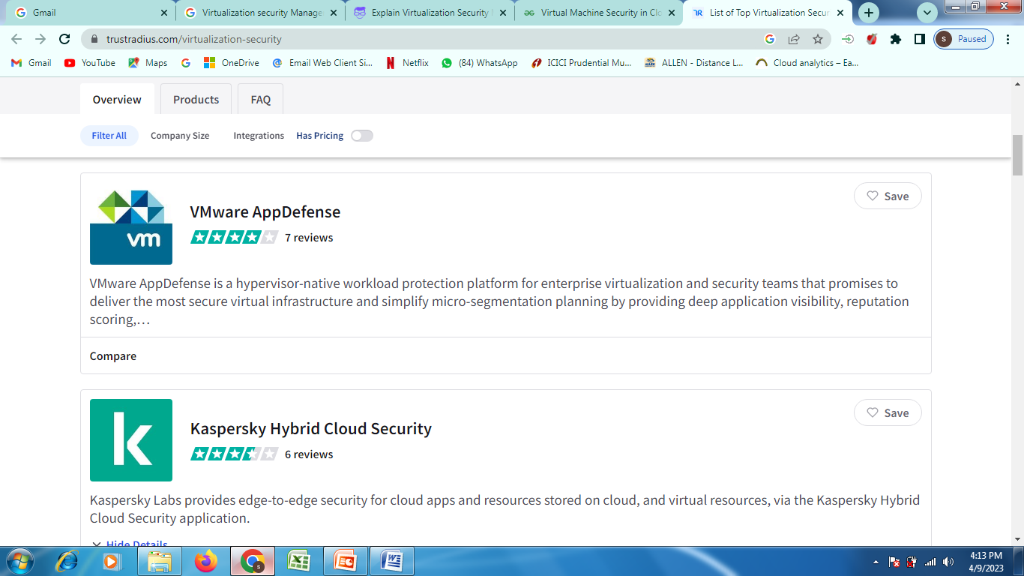
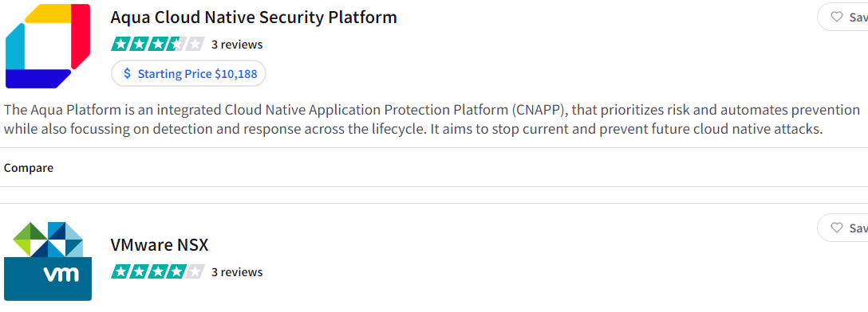
Virtualization security Management Cont…..
Notes:
Tools for Functional Testing in Cloud
There are many tools used for testing performance, load, stress testing in or of cloud. Some of these testing tools are mentioned below:
AppPerfect: AppPerfect is a software development company located in Sunnyvale, CA. It markets supports and develops a set of testing and monitoring products that are used to analyze, test, and monitor web and windows-based applications.
Jmeter: Apache JMeter is an open-source, Java-based application software designed to load testing tools to analyze and monitor the performance of the services and web applications.
SOASTA CloudTest: SOASTA cloud test is a cross-platform test management tool with a user-friendly design.
LoadStorm: It is a tool to manage and monitor the performance of the entire cloud infrastructure and produces a real-time graph for performance analysis.
Tools for Security Testing in Cloud
The following are the tools for security testing in the cloud:
Nessus: Nessus is a remote security scanning tool that scans the system and raises an alert if any vulnerability is discovered that hackers could use to get unauthorized access to sensitive data.
Wireshark: Wireshark is an open-source packet analyzer used for network troubleshooting and monitoring, software, and communications protocols development.
Nmap: Nmap is a network scanner that is used to discover hosts and services on a network by sending packets and analyzing the response.
Benefits Of Cloud Testing
The following are some of the benefits of cloud testing:
Availability of Required testing environment: In cloud testing, testing teams can easily replicate the customer’s environment for effective testing of the cloud without investing in the additional hardware and software resources for testing. These resources can be accessed from any device with a network connection.
Less expensive: Cloud testing is more cost-efficient than traditional methods of testing, as there is no need of investing in additional hardware and software resources. Customers, as well as the testing team, only pay for what they use.
Faster testing: Cloud testing is faster than the traditional method of testing as most of the management tasks like physical infrastructure management for testing are removed.
Scalability: The cloud computing resources can be increased and decreased whenever required, based on testing demands.
Customization: Cloud testing can be customized as per the usage, cost and time based on the variety of users and user’s environment.
Disaster recovery: Disaster recovery is easily possible as the data backup is taken at the cloud vendors as well as at the user’s end also.

Slide 81
Secure Cloud Software Requirements
Comprehensive and structured overview of cloud computing security requirements and solutions.
Security requirements has been classified in six sub-areas: Access Control, Attack/Harm Detection, Non-repudiation, Integrity, Security Auditing, Privacy
Access Control: This is the degree to which the system limits access to its resources only to authorized entities (e.g. human users, programs, processes, devices). Hence, access control security requirements address the need to recognize parties that want to interact with the system, making sure that the parties are who they say they are and giving them access only to the resources they are allowed to access
Notes:
Tools for Functional Testing in Cloud
There are many tools used for testing performance, load, stress testing in or of cloud. Some of these testing tools are mentioned below:
AppPerfect: AppPerfect is a software development company located in Sunnyvale, CA. It markets supports and develops a set of testing and monitoring products that are used to analyze, test, and monitor web and windows-based applications.
Jmeter: Apache JMeter is an open-source, Java-based application software designed to load testing tools to analyze and monitor the performance of the services and web applications.
SOASTA CloudTest: SOASTA cloud test is a cross-platform test management tool with a user-friendly design.
LoadStorm: It is a tool to manage and monitor the performance of the entire cloud infrastructure and produces a real-time graph for performance analysis.
Tools for Security Testing in Cloud
The following are the tools for security testing in the cloud:
Nessus: Nessus is a remote security scanning tool that scans the system and raises an alert if any vulnerability is discovered that hackers could use to get unauthorized access to sensitive data.
Wireshark: Wireshark is an open-source packet analyzer used for network troubleshooting and monitoring, software, and communications protocols development.
Nmap: Nmap is a network scanner that is used to discover hosts and services on a network by sending packets and analyzing the response.
Benefits Of Cloud Testing
The following are some of the benefits of cloud testing:
Availability of Required testing environment: In cloud testing, testing teams can easily replicate the customer’s environment for effective testing of the cloud without investing in the additional hardware and software resources for testing. These resources can be accessed from any device with a network connection.
Less expensive: Cloud testing is more cost-efficient than traditional methods of testing, as there is no need of investing in additional hardware and software resources. Customers, as well as the testing team, only pay for what they use.
Faster testing: Cloud testing is faster than the traditional method of testing as most of the management tasks like physical infrastructure management for testing are removed.
Scalability: The cloud computing resources can be increased and decreased whenever required, based on testing demands.
Customization: Cloud testing can be customized as per the usage, cost and time based on the variety of users and user’s environment.
Disaster recovery: Disaster recovery is easily possible as the data backup is taken at the cloud vendors as well as at the user’s end also.

Slide 82
Secure Cloud Software Requirements Cont….
Attach Harm Detection
This refers to the detection, recording, and notification requirements when an attack is attempted and/or succeeds.
Currently, four groups of solutions are proposed.
The first group includes cloud firewalls as the filtering mechanism for attack prevention. Their essential feature is their dynamic and intelligent technology to take full advantage of the cloud to sample and share threat information dynamically and in real time
The second group refers to security-measuring framework suitable to SaaS. For example, the framework in aims to determine the status of user-level applications in guest VMs that have run for a period of time.
The third category of solutions is cloud community watch services that rely on millions of CSU (User)s for constant analysis to detect newly injected malware attacks.
The fourth group covers multi-technology based approaches, e.g. for example, the cloud security based intelligent Network-based Intrusion Prevention system (NIPS) that includes four key technologies – active defense technology, linkage technology with firewall, synthesis detecting method, and hardware acceleration system, to block visits under the real-time determination.
Notes:
Tools for Functional Testing in Cloud
There are many tools used for testing performance, load, stress testing in or of cloud. Some of these testing tools are mentioned below:
AppPerfect: AppPerfect is a software development company located in Sunnyvale, CA. It markets supports and develops a set of testing and monitoring products that are used to analyze, test, and monitor web and windows-based applications.
Jmeter: Apache JMeter is an open-source, Java-based application software designed to load testing tools to analyze and monitor the performance of the services and web applications.
SOASTA CloudTest: SOASTA cloud test is a cross-platform test management tool with a user-friendly design.
LoadStorm: It is a tool to manage and monitor the performance of the entire cloud infrastructure and produces a real-time graph for performance analysis.
Tools for Security Testing in Cloud
The following are the tools for security testing in the cloud:
Nessus: Nessus is a remote security scanning tool that scans the system and raises an alert if any vulnerability is discovered that hackers could use to get unauthorized access to sensitive data.
Wireshark: Wireshark is an open-source packet analyzer used for network troubleshooting and monitoring, software, and communications protocols development.
Nmap: Nmap is a network scanner that is used to discover hosts and services on a network by sending packets and analyzing the response.
Benefits Of Cloud Testing
The following are some of the benefits of cloud testing:
Availability of Required testing environment: In cloud testing, testing teams can easily replicate the customer’s environment for effective testing of the cloud without investing in the additional hardware and software resources for testing. These resources can be accessed from any device with a network connection.
Less expensive: Cloud testing is more cost-efficient than traditional methods of testing, as there is no need of investing in additional hardware and software resources. Customers, as well as the testing team, only pay for what they use.
Faster testing: Cloud testing is faster than the traditional method of testing as most of the management tasks like physical infrastructure management for testing are removed.
Scalability: The cloud computing resources can be increased and decreased whenever required, based on testing demands.
Customization: Cloud testing can be customized as per the usage, cost and time based on the variety of users and user’s environment.
Disaster recovery: Disaster recovery is easily possible as the data backup is taken at the cloud vendors as well as at the user’s end also.

Slide 83
Secure Cloud Software Requirements Cont….
Integrity
This is about how well various components are protected from intentional and unauthorized corruption.
Integrity can be broken down to data integrity, hardware integrity, personal integrity and software integrity.
The current solutions to integrity requirements are:
Service Level Agreements (SLA) based 2. Multi-Model based
3. VM-focused.
Security requirement for the cloud must be included in the SLA, the document which defines the relationship between the CSP and the CSU.
The multi-model approaches deploy models differently responding to security related features. For Eg.: five models deal with separation, availability, migration, data tunnel and cryptography, respectively, a tunnel and a cryptography models work together to guarantee data security during storage and transmission.
VM-focused approaches ensure integrity by increasing the requirements for VM security. In systems where multiple VMs are co-located on the same physical server, a malicious user having control of a VM can try to gain control over other VM’s resources or utilize all system resources leading to denial of resource attack over other VM users, or steal data located on the server.
Notes:
Tools for Functional Testing in Cloud
There are many tools used for testing performance, load, stress testing in or of cloud. Some of these testing tools are mentioned below:
AppPerfect: AppPerfect is a software development company located in Sunnyvale, CA. It markets supports and develops a set of testing and monitoring products that are used to analyze, test, and monitor web and windows-based applications.
Jmeter: Apache JMeter is an open-source, Java-based application software designed to load testing tools to analyze and monitor the performance of the services and web applications.
SOASTA CloudTest: SOASTA cloud test is a cross-platform test management tool with a user-friendly design.
LoadStorm: It is a tool to manage and monitor the performance of the entire cloud infrastructure and produces a real-time graph for performance analysis.
Tools for Security Testing in Cloud
The following are the tools for security testing in the cloud:
Nessus: Nessus is a remote security scanning tool that scans the system and raises an alert if any vulnerability is discovered that hackers could use to get unauthorized access to sensitive data.
Wireshark: Wireshark is an open-source packet analyzer used for network troubleshooting and monitoring, software, and communications protocols development.
Nmap: Nmap is a network scanner that is used to discover hosts and services on a network by sending packets and analyzing the response.
Benefits Of Cloud Testing
The following are some of the benefits of cloud testing:
Availability of Required testing environment: In cloud testing, testing teams can easily replicate the customer’s environment for effective testing of the cloud without investing in the additional hardware and software resources for testing. These resources can be accessed from any device with a network connection.
Less expensive: Cloud testing is more cost-efficient than traditional methods of testing, as there is no need of investing in additional hardware and software resources. Customers, as well as the testing team, only pay for what they use.
Faster testing: Cloud testing is faster than the traditional method of testing as most of the management tasks like physical infrastructure management for testing are removed.
Scalability: The cloud computing resources can be increased and decreased whenever required, based on testing demands.
Customization: Cloud testing can be customized as per the usage, cost and time based on the variety of users and user’s environment.
Disaster recovery: Disaster recovery is easily possible as the data backup is taken at the cloud vendors as well as at the user’s end also.

Slide 84
Secure Cloud Software Requirements Cont….
Security Auditing:
This is about enabling the security personnel (workforce) to audit the status and use of security mechanisms by analyzing security related events.
This is usually done for the purpose of achieving compliance to laws and regulations or accountability and control.
Approaches to security audibility requirements is based on security configuration management and vulnerability assessment.
For example, assesing the vulnerabilities of each VM in an infrastructure
A logging framework could be very useful for security auditing.
Data protection scheme with public auditing provides a mechanism to allow for data to be encrypted in the cloud without loss of accessibility or functionality for authorized parties.
On the PaaS layer, need to model security requirements for dynamic provision and configure security services and link operational security events to vulnerabilities and impact assessments at the business level.
Notes:
Tools for Functional Testing in Cloud
There are many tools used for testing performance, load, stress testing in or of cloud. Some of these testing tools are mentioned below:
AppPerfect: AppPerfect is a software development company located in Sunnyvale, CA. It markets supports and develops a set of testing and monitoring products that are used to analyze, test, and monitor web and windows-based applications.
Jmeter: Apache JMeter is an open-source, Java-based application software designed to load testing tools to analyze and monitor the performance of the services and web applications.
SOASTA CloudTest: SOASTA cloud test is a cross-platform test management tool with a user-friendly design.
LoadStorm: It is a tool to manage and monitor the performance of the entire cloud infrastructure and produces a real-time graph for performance analysis.
Tools for Security Testing in Cloud
The following are the tools for security testing in the cloud:
Nessus: Nessus is a remote security scanning tool that scans the system and raises an alert if any vulnerability is discovered that hackers could use to get unauthorized access to sensitive data.
Wireshark: Wireshark is an open-source packet analyzer used for network troubleshooting and monitoring, software, and communications protocols development.
Nmap: Nmap is a network scanner that is used to discover hosts and services on a network by sending packets and analyzing the response.
Benefits Of Cloud Testing
The following are some of the benefits of cloud testing:
Availability of Required testing environment: In cloud testing, testing teams can easily replicate the customer’s environment for effective testing of the cloud without investing in the additional hardware and software resources for testing. These resources can be accessed from any device with a network connection.
Less expensive: Cloud testing is more cost-efficient than traditional methods of testing, as there is no need of investing in additional hardware and software resources. Customers, as well as the testing team, only pay for what they use.
Faster testing: Cloud testing is faster than the traditional method of testing as most of the management tasks like physical infrastructure management for testing are removed.
Scalability: The cloud computing resources can be increased and decreased whenever required, based on testing demands.
Customization: Cloud testing can be customized as per the usage, cost and time based on the variety of users and user’s environment.
Disaster recovery: Disaster recovery is easily possible as the data backup is taken at the cloud vendors as well as at the user’s end also.

Slide 85
Secure Cloud Software Requirements Cont….
Privacy
This is about preventing unauthorized parties from obtaining sensitive information.
It includes two aspects to privacy – anonymity and confidentiality.
Solutions to enhance privacy include the use of cloud-based malware scanners and data fragmentation technology to hide the association between data attributes, or the separation of the CSUs’ data from the software.
Non-repudiation
This subarea includes requirements about preventing a party to an interaction with the cloud to deny the interaction
It enables the recording of visitor’s information and makes it very hard for the CSUs to deceive about their identity information
Another solution is the multi-party non-repudiation (MPNR) protocol, which provides a fair non-repudiation storage cloud and also prevents roll-back attacks .
[Roll-back: an attacker forces the target system to switch to a low-quality, less secure mode of operation]
[Nonrepudiation ensures that no party can deny that it sent or received a message via encryption and/or digital signatures or approved some information.]
Notes:
Tools for Functional Testing in Cloud
There are many tools used for testing performance, load, stress testing in or of cloud. Some of these testing tools are mentioned below:
AppPerfect: AppPerfect is a software development company located in Sunnyvale, CA. It markets supports and develops a set of testing and monitoring products that are used to analyze, test, and monitor web and windows-based applications.
Jmeter: Apache JMeter is an open-source, Java-based application software designed to load testing tools to analyze and monitor the performance of the services and web applications.
SOASTA CloudTest: SOASTA cloud test is a cross-platform test management tool with a user-friendly design.
LoadStorm: It is a tool to manage and monitor the performance of the entire cloud infrastructure and produces a real-time graph for performance analysis.
Tools for Security Testing in Cloud
The following are the tools for security testing in the cloud:
Nessus: Nessus is a remote security scanning tool that scans the system and raises an alert if any vulnerability is discovered that hackers could use to get unauthorized access to sensitive data.
Wireshark: Wireshark is an open-source packet analyzer used for network troubleshooting and monitoring, software, and communications protocols development.
Nmap: Nmap is a network scanner that is used to discover hosts and services on a network by sending packets and analyzing the response.
Benefits Of Cloud Testing
The following are some of the benefits of cloud testing:
Availability of Required testing environment: In cloud testing, testing teams can easily replicate the customer’s environment for effective testing of the cloud without investing in the additional hardware and software resources for testing. These resources can be accessed from any device with a network connection.
Less expensive: Cloud testing is more cost-efficient than traditional methods of testing, as there is no need of investing in additional hardware and software resources. Customers, as well as the testing team, only pay for what they use.
Faster testing: Cloud testing is faster than the traditional method of testing as most of the management tasks like physical infrastructure management for testing are removed.
Scalability: The cloud computing resources can be increased and decreased whenever required, based on testing demands.
Customization: Cloud testing can be customized as per the usage, cost and time based on the variety of users and user’s environment.
Disaster recovery: Disaster recovery is easily possible as the data backup is taken at the cloud vendors as well as at the user’s end also.

